Slide 1

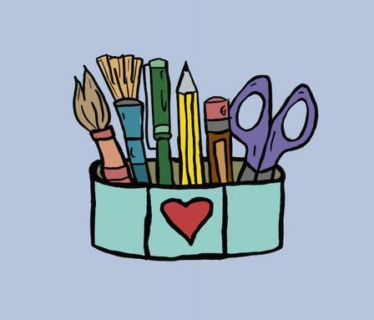
Morning Meeting Guide
Week One
©2026 Pencil Box Solutions

Slide 2



Morning Meetings
First, take a deep breath, you’ve already done so much. All the planning, prepping, organizing, and thinking ahead... it shows how much heart you pour into your work. We see you, and we’re cheering you on. By choosing to start your days with our Morning Meeting video series, you’re not only setting your students up for success, you’re taking an important first step in caring for yourself, too. And that matters. When you’re grounded, encouraged, and equipped, the impact you make on your students will ripple far beyond the classroom. This year, you’re already making a huge difference, you’ve got this!
Greta and the Pencil Box Team
©2026 Pencil Box Solutions

Slide 3
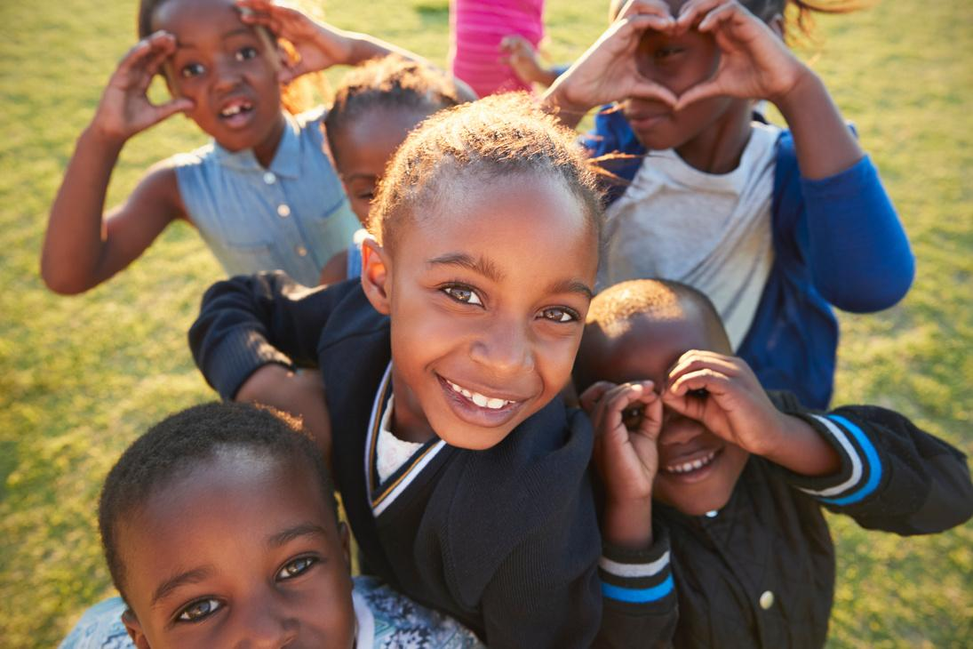



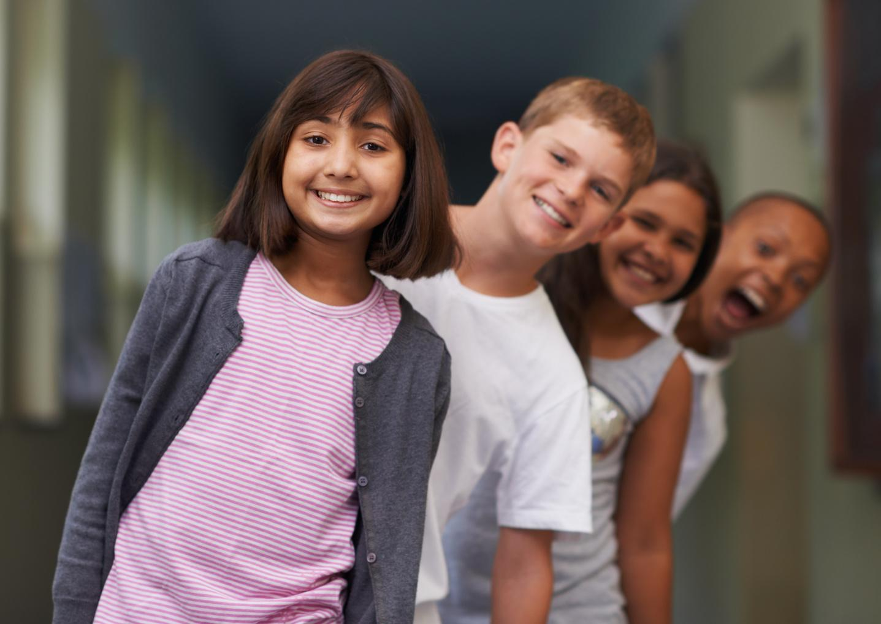
Week 1 Overview
Day 1
Day 3
Day 5
You Belong
Day 2
Day 4
Kindness at
the Center
Setting
Intentions
Safe and Respectful
Classroom
Routines
©2026 Pencil Box Solutions

Slide 4

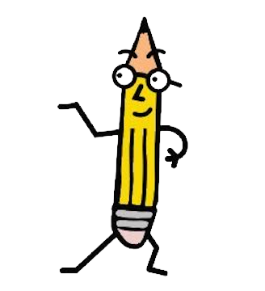
Day One
Psst . . . did you know that I am hidden in every video?
Week One
©2026 Pencil Box Solutions

Slide 5


Day One
Welcome Friends,
You’re HERE. You’re FINALLY HERE! We are so glad you are here today! Today is the beginning of all the fun, learning, and growing we’ll do together. It’s okay to feel excited, nervous, or even a little unsure, that’s a typical first day! Just remember: this is a safe place, and we’re going to take care of each other. You belong here. We’re a team, and this is going to be a great year!
©2026 Pencil Box Solutions

Slide 6

You Belong
©2026 Pencil Box Solutions

Slide 7
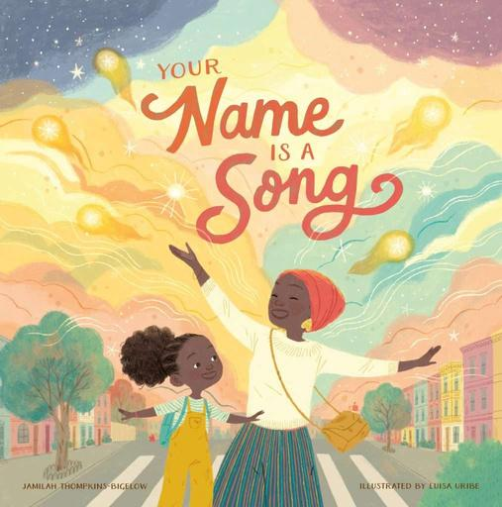

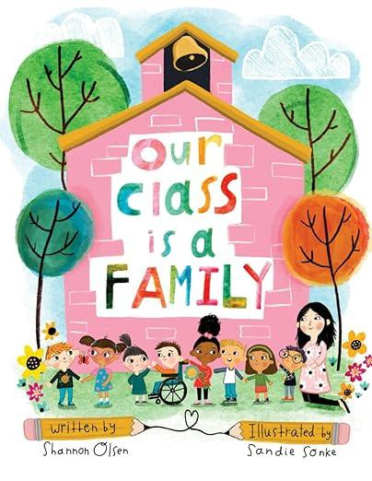
Recommended
Read Alouds
for Primary
by Jamilah Thompkins-Bigelow
by Adam Rex
by Shannon Olsen
©2026 Pencil Box Solutions

Slide 8
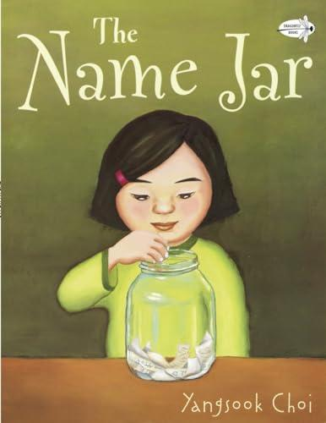

Recommended
Read Alouds
for Upper Grades
by Yangsook Choi
by Patricia Polacco
by Adam Rex
©2026 Pencil Box Solutions

Slide 9
Name Game
Students and the teacher sit in a circle. The teacher holds a stopwatch and times the students how quickly they can each say their name as they go around the circle one at a time.
The person to the left of the teacher starts the clockwise direction. Teacher announces the time. Then students are challenged to beat their time. The child on the left is congratulated, “Nice work, Team A.”
After two clockwise rounds, the teacher turns to the student on the right and says, “Now it’s your turn, Team B.” The student to the right will begin the counter clockwise direction. Team B gets one additional turn to try to beat their first score and the score of “Team A”.
Then, the teacher announces a race, Team A will challenge Team B. They will both start first and whoever reaches the end first is declared the winner!
©2026 Pencil Box Solutions

Slide 10
Name Game continued
While this game is fun and silly, the reality is we are all on the same team.
We are winners when everyone can participate and have fun.
This year there will be times when we win and there will be even more times when we lose.
Listen to Roger Federer’s speech at Dartmouth. Federer is one of the world’s greatest tennis players.
https://www.youtube.com/watch?v=_ILk8Yai3Wo
Negative energy is wasted energy. The best accepts their loses and then moves on.
©2026 Pencil Box Solutions

Slide 11
Day Two
Could you find me?
Week One
©2026 Pencil Box Solutions

Slide 12
Day Two
Good morning, everyone!
It’s our second day together, and already I can tell this is going to be a special group. Today, let’s remember that every choice we make, every word we speak, and every action we do helps make our classroom feel safe, kind, and respectful for everyone.
We ALL belong here, and today we are going to create together a class agreement, which will help us all feel safe and respected.
©2026 Pencil Box Solutions

Slide 13
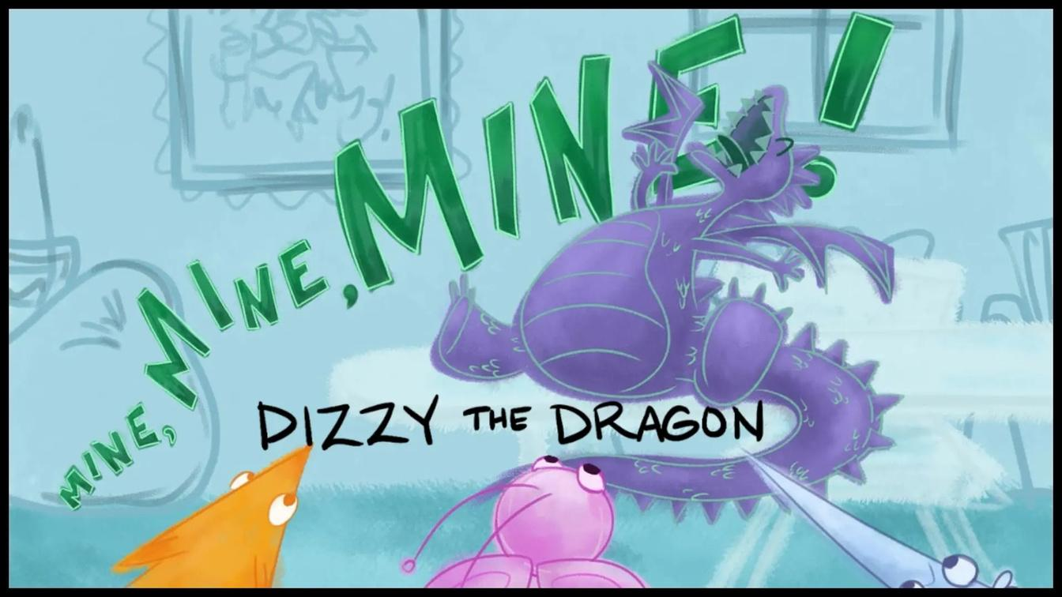
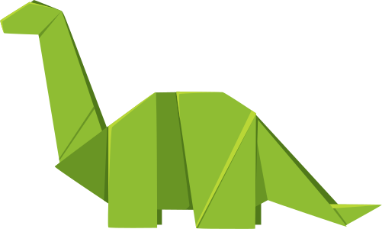
Meet Dizzy
©2026 Pencil Box Solutions

Slide 14




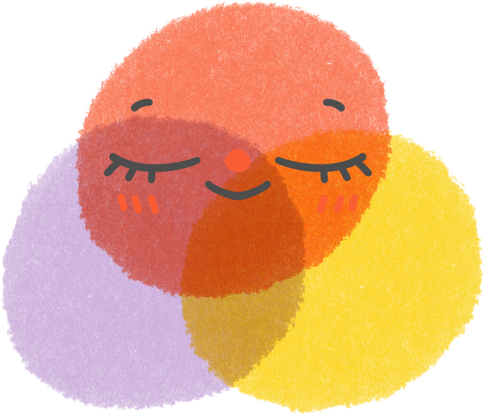
What makes a safe and respectful classroom?
LOOK LIKE?
What does it ...
SOUND LIKE?
FEEL LIKE?
©2026 Pencil Box Solutions

Slide 15
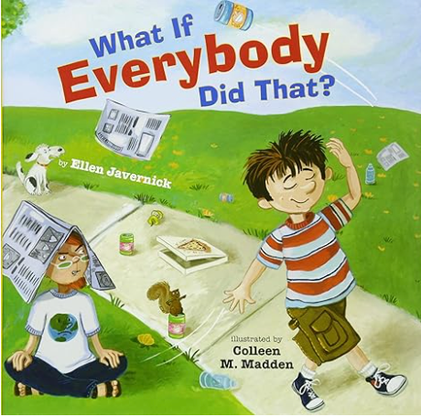

Recommended
Read Alouds
by Ellen Javernick
by Bryan Smith
©2026 Pencil Box Solutions

Slide 16
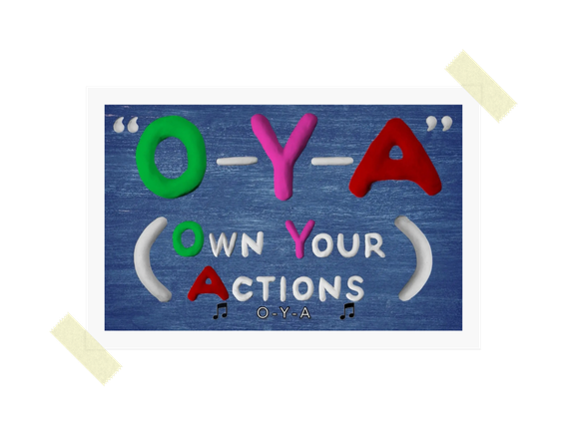
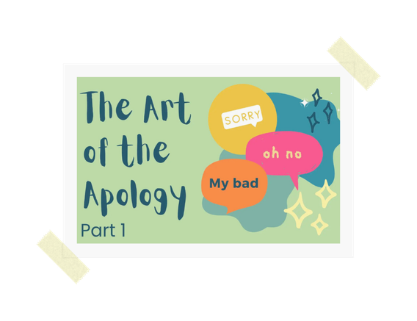
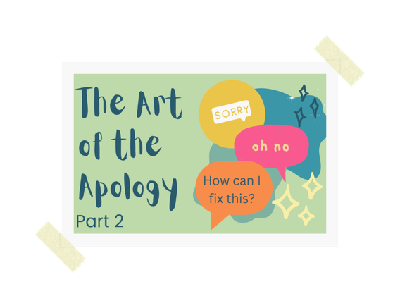
What if an agreement
is broken?
OYA
APOLOGIZE
FIX IT AND MOVE ON
Need additional support?
Check out these videos on PBS website.
©2026 Pencil Box Solutions

Slide 17
BUZZ
This is a low impact game. In other words, most kids can feel successful without having the pressure of a spotlight on them.
Primary students: skip counting by 2s, 5s, or 10s, etc.
Upper Elementary students: skip counting by multiples
Goal: Last one standing. Or part of the last three students standing.
Everyone stands in a circle. The teacher determines the skip counting number appropriate to the grade level. Students go around the circle counting in order beginning at 1 counting one number in order at a time. (Or for a challenge a negative number.) When the student reaches the appointed “number” that is one of the numbers they say “BUZZ” instead, and they are out and sit down. Then continue with the count.
Example (skip counting by 10s): 1, 2, 3, 4, 5, 6, 7, 8, 9, BUZZ, 11, 12, 13, 14, 15, 16, 17, 18, 19, BUZZ, 21 . . . continue until only one student is left (Or for variety 3 students are left.)
©2026 Pencil Box Solutions

Slide 18

Day Three
Week One
©2026 Pencil Box Solutions

Slide 19
Day Three
Welcome to Day Three Scholars,
Kindness is like planting tiny seeds. You might not see what grows right away, but every kind action—big or small—helps something beautiful bloom. Let’s look for ways to spread kindness today, even in quiet ways that only you will know about.
Today we are focusing on acts of kindness and patience as we practice a lot of new routines to build healthy habits!
©2026 Pencil Box Solutions

Slide 20

Kindness Counts
It might not seem like much, but every act of kindness matters.
And in our class, kindness is a priority.
©2026 Pencil Box Solutions

Slide 21


Recommended
Read Alouds
by Patrice Barton
by Emily Pearson
©2026 Pencil Box Solutions

Slide 22
Name and Action
This game requires a little more comfort, however, it is a great way to learn names.
Everyone stands in a circle. Each student gets a turn to say their name and do an action. All actions should be silly and fun, not inappropriate.
Primary students: echo back the speakers name and complete the action.
Upper Elementary students: name and action are cumulative, so every time an action is completed you will add another from the next person on the circle.
Goal: Recall the names of your classmates.
©2026 Pencil Box Solutions

Slide 23


Day Four
Week One
©2026 Pencil Box Solutions

Slide 24
Day Four
Top of the Morning to You,
Just like brushing your teeth or tying your shoes, classroom routines get easier with practice. The more we do them, the more they become habits, and those habits help us learn more and worry less!
Today we are going to keep practicing those routines, in order to make room for more fun later!
Let’s make today great!
©2026 Pencil Box Solutions

Slide 25
Routines are SO
ROUTINE
©2026 Pencil Box Solutions

Slide 26


Recommended
Read Alouds
by Peggy Rathman
by Hannah Shaw
©2026 Pencil Box Solutions

Slide 27
Let’s Go Camping!
This game requires a little more comfort, however, it is a great way for students to move around and work together . When the teacher says the following you move accordingly:
Take a Hike: (This is also the reset when many are out and you want to start again.) Walk around the room by yourself.
Build a Fire: Two students get together. One sits or kneels and waves their arms above their head like a flame, while the other rubs their hands together over the flames.
Pitch a Tent: Three students get togther. One sits or kneels, while the other two stand over, join hands, and make a tent.
Smores: Four students gather together. They stand in a line representing chocolate and marshmallow surrounded by graham crackers.
Goal: Anyone who is unable to find the others to complete the command is out, but this can be played non-competitively as well by using the reset “Take a hike”. Encourage students to find different people each time.
©2026 Pencil Box Solutions

Slide 28
Day Five
Week One
©2026 Pencil Box Solutions

Slide 29
Day Five
Welcome Intentional Scholars!
Imagine you had a secret superhero word that helped you be your best self all year long. What would your word be? Maybe focus, respect, or joy. Today we’ll each pick ONE word that isn’t about getting good grades— although doing your best in reading, writing, and math is important, it’s about growing your heart and your character. It’s about helping you become the best version of yourself.
©2026 Pencil Box Solutions

Slide 30

Setting An Intention
©2026 Pencil Box Solutions

Slide 31

Suggested Read
Aloud
(Though this book is full of beautiful intention setting meaning, it does not have a plot, or a story line.
©2026 Pencil Box Solutions

Slide 32
Setting an Intention
Encouraging – Open-Minded – Patient – Determined – Honest – Grateful – Helpful – Compassionate – Hardworking – Curious – Hopeful – Flexible – Caring – Peaceful – Positive – Confident – Generous – Inclusive – Listener – Thoughtful – Responsible – Trustworthy – Gentle
SYNTHESIS 1
Wow any audience with your Canva presentation. Design, plan and present all in one place.
SYNTHESIS 2
Wow any audience with your Canva presentation. Design, plan and present all in one place.
SYNTHESIS 3
Wow any audience with your Canva presentation. Design, plan and present all in one place.
©2026 Pencil Box Solutions

Slide 33


Recommended
Read Alouds
by Lisa Frenkel
Riddiough
a journal by Positive Kids World
©2026 Pencil Box Solutions

Slide 34
Wooly Bully
This game requires a little more comfort, however, it is a great way for students to move around and work together. Divide the class into two teams. Draw or create an invisible divider down the middle of the room. Ask students to stand with their team in a line equal distance away from the center line. (This game is based off of Rock-Paper-Scissors concept, so you may have to play basic Rock-Paper-Scissors first.)
Sheep (on all fours) outwits Shepherd (stand tall)
Shepherd (stand tall) outwits Wooly Bully (monster like with hands raised)
Wooly Bully (monster like with hands raised) outwits Sheep (on all fours)
The teacher draws a name from each team. They get to choose their action. Each team huddles up and the decision maker whispers what the action will be.
The teacher calls, “Uno, dos, one, two, tres, quatro.” (You can play the song for even more fun.) When you get to the quatro the team displays their action. The team that “outwits” the other team gets to take one step towards the center line. The first team to reach the center line is the winning team!
©2026 Pencil Box Solutions

Slide 35

YOU DID IT!
WEEK ONE
©2026 Pencil Box Solutions

