Slide 1



Morning Meeting Guide
Week Two
©2026 Pencil Box Solutions

Slide 2



Morning Meetings
Welcome to Week Two—the week when real personalities start to peek out, routines get tested, and those “honeymoon vibes” may begin to fade. This is not a sign that things are going wrong. It’s a sign that your students are starting to feel safe enough to be themselves.
The behaviors you see now are not barriers—they're invitations. Invitations to teach, to guide, to connect. Keep showing up with consistency, compassion, and calm. You are building something lasting, even when it feels messy.
Your patience today is planting peace for tomorrow. You've got this—and more importantly, your students have YOU impacting their lives.
Greta and the Pencil Box Team
©2026 Pencil Box Solutions

Slide 3
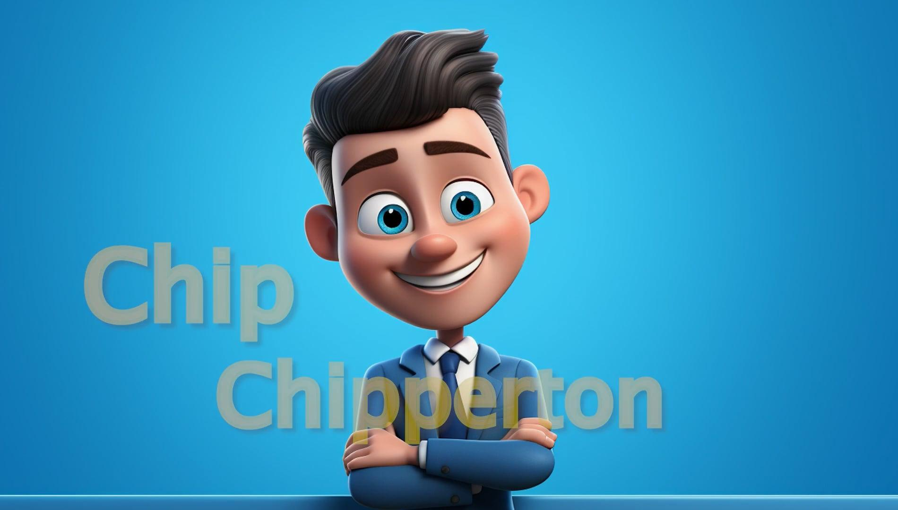
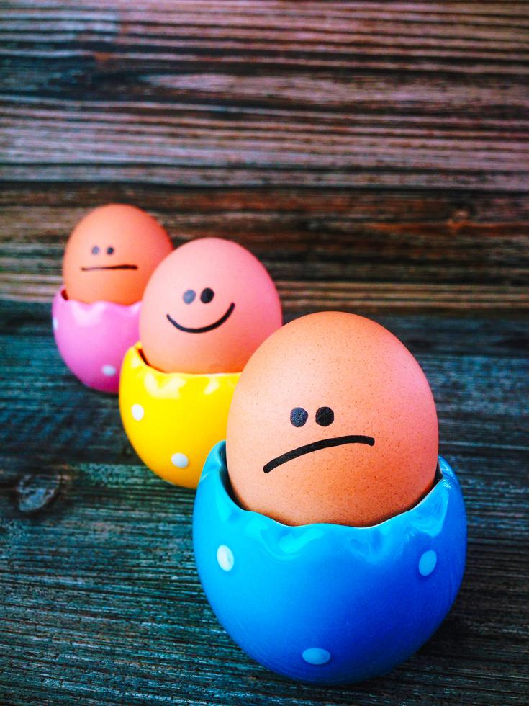


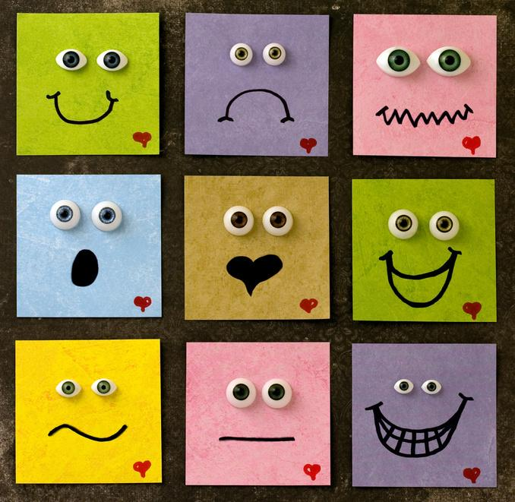
Week 2 Overview
Day 1
Day 3
Day 5
Day 4
Notice Feelings
Day 2
Face Those
Feelings
Stop Light in
My Body
What’s Bugging You?
Name Feelings
©2026 Pencil Box Solutions

Slide 4
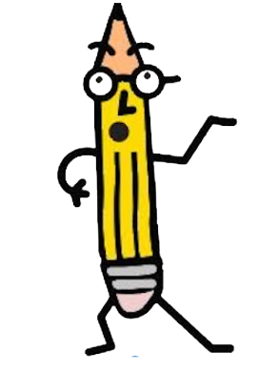
Week Two
Day One
©2026 Pencil Box Solutions

Slide 5
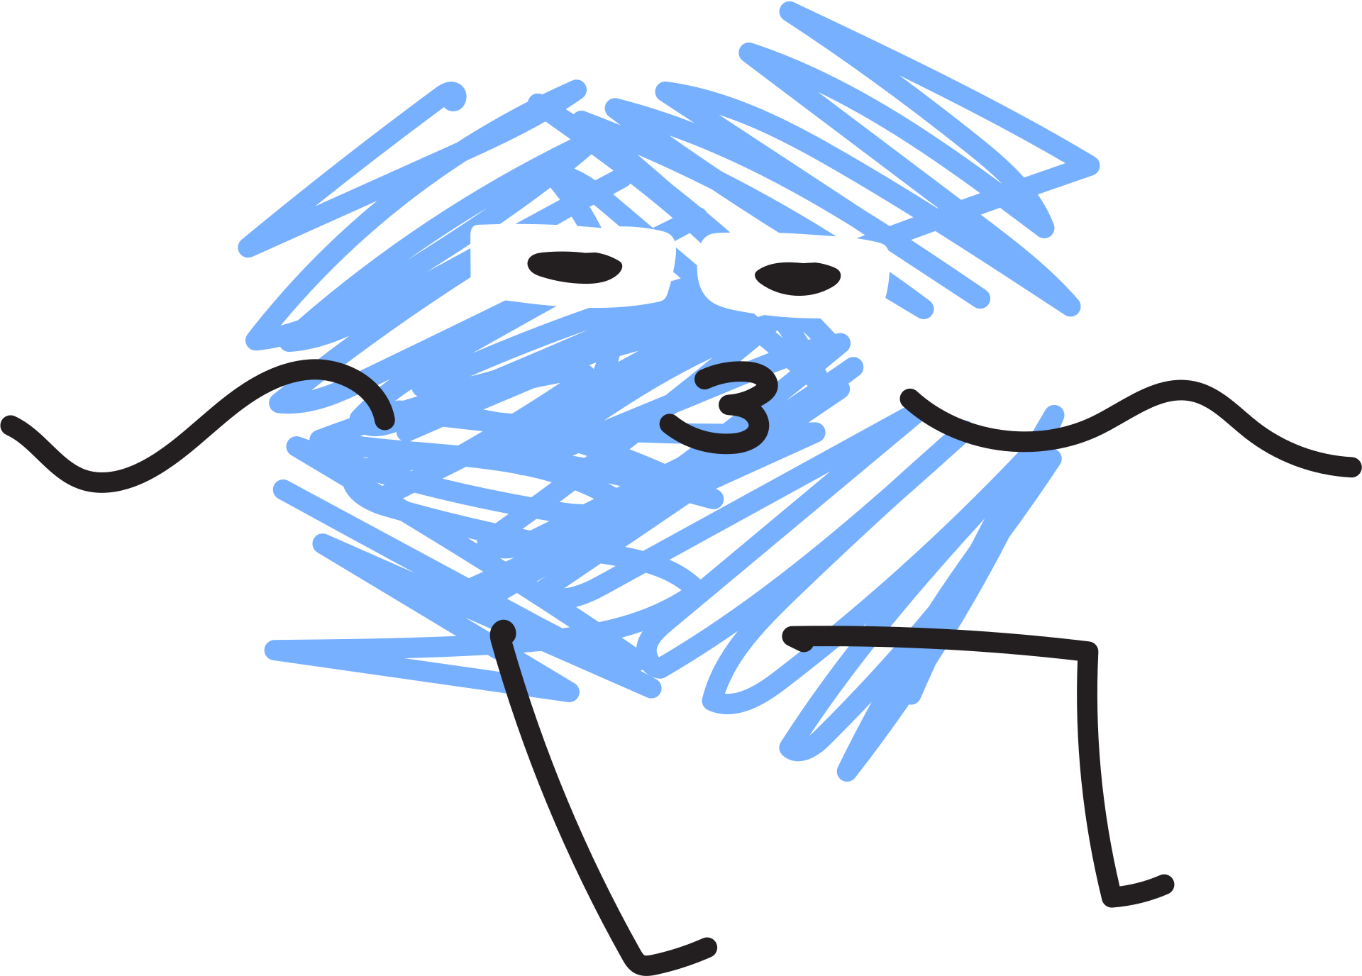
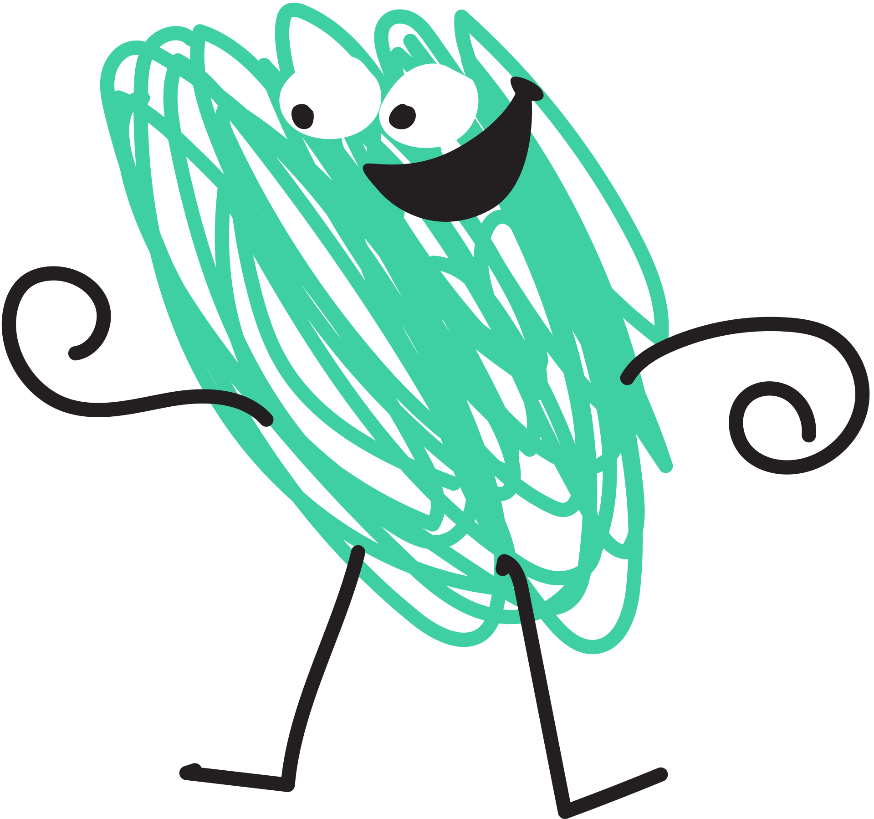

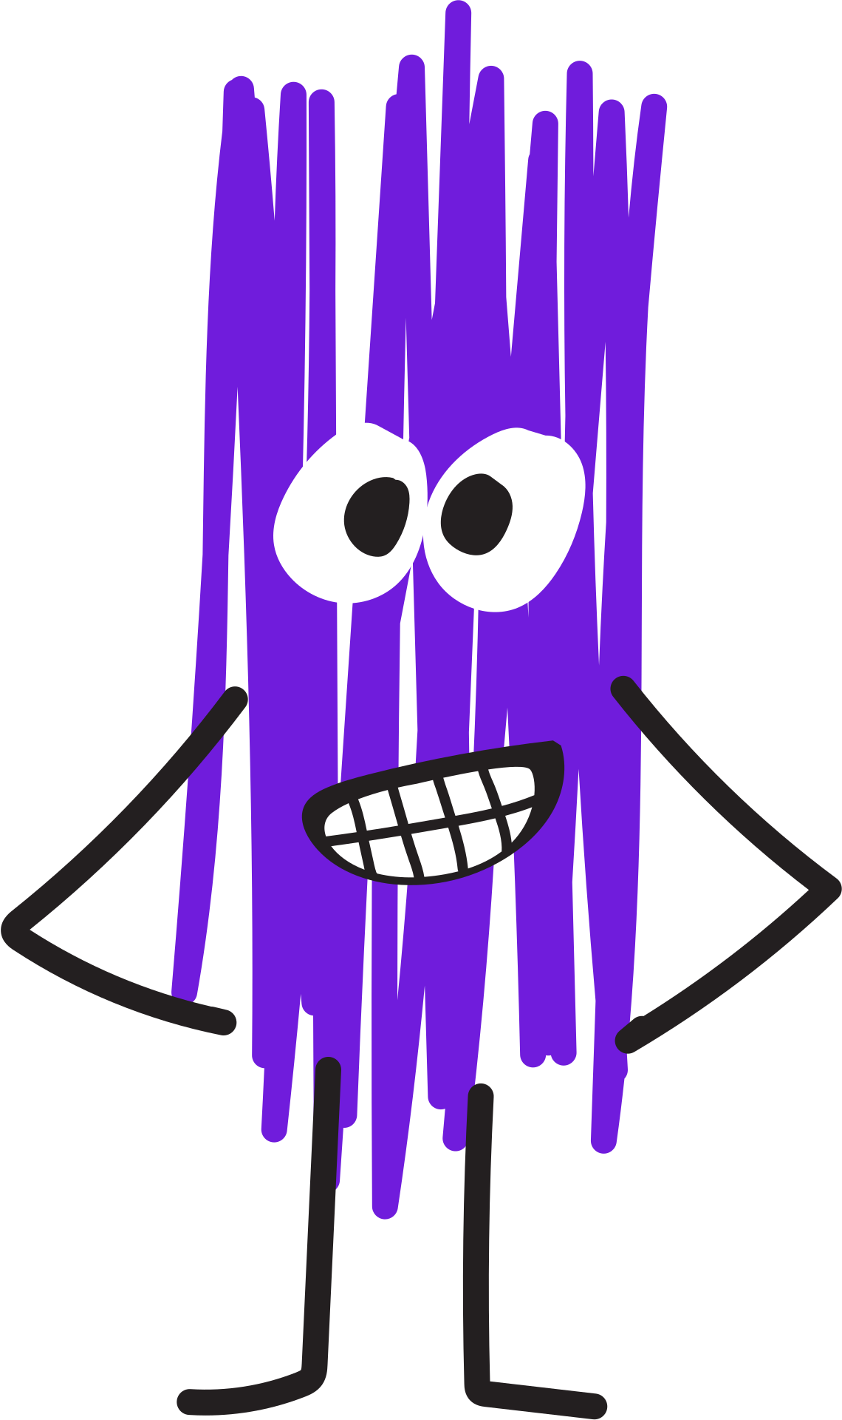
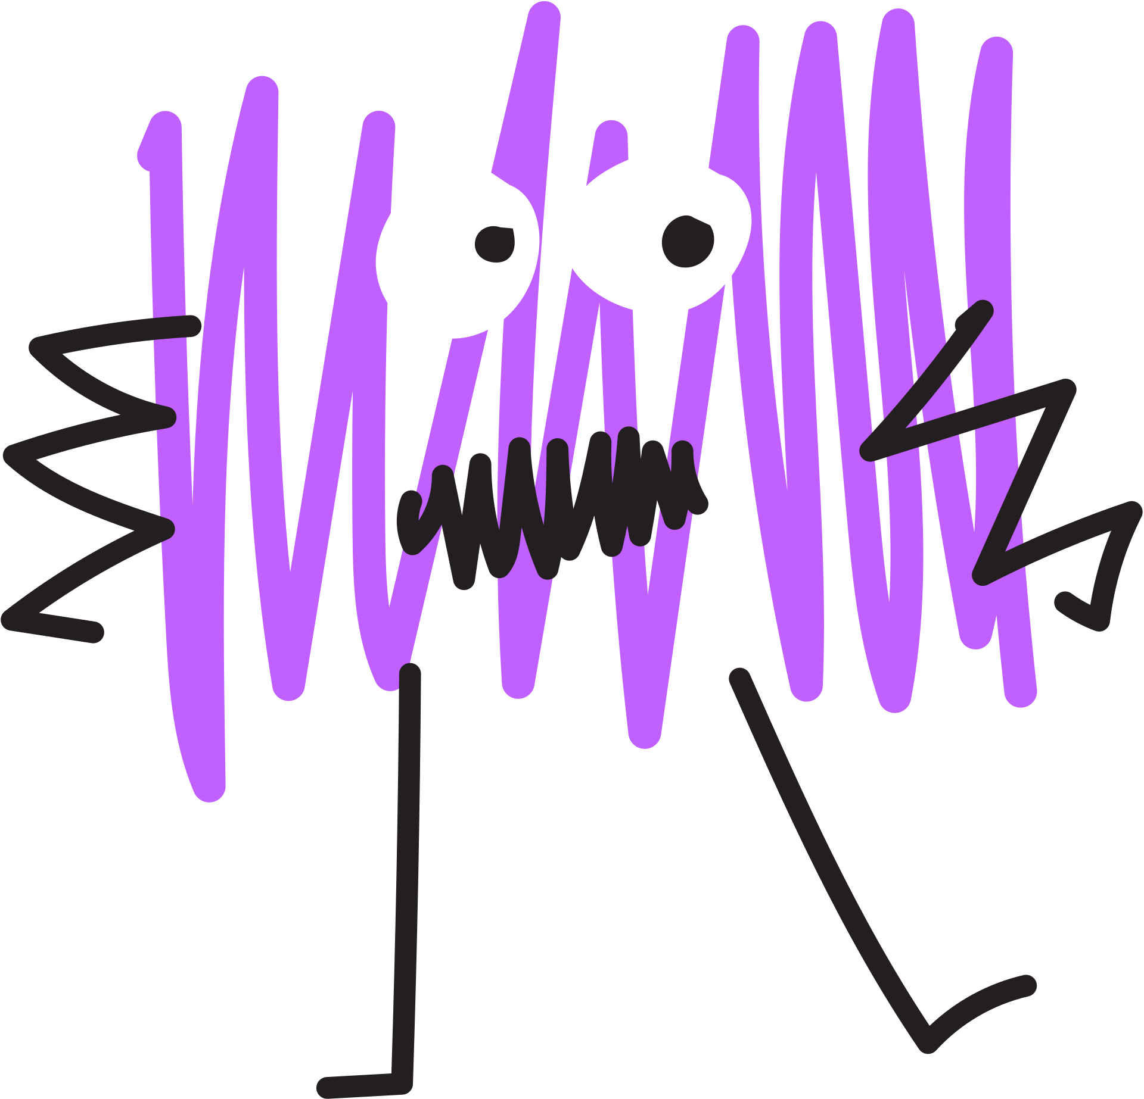
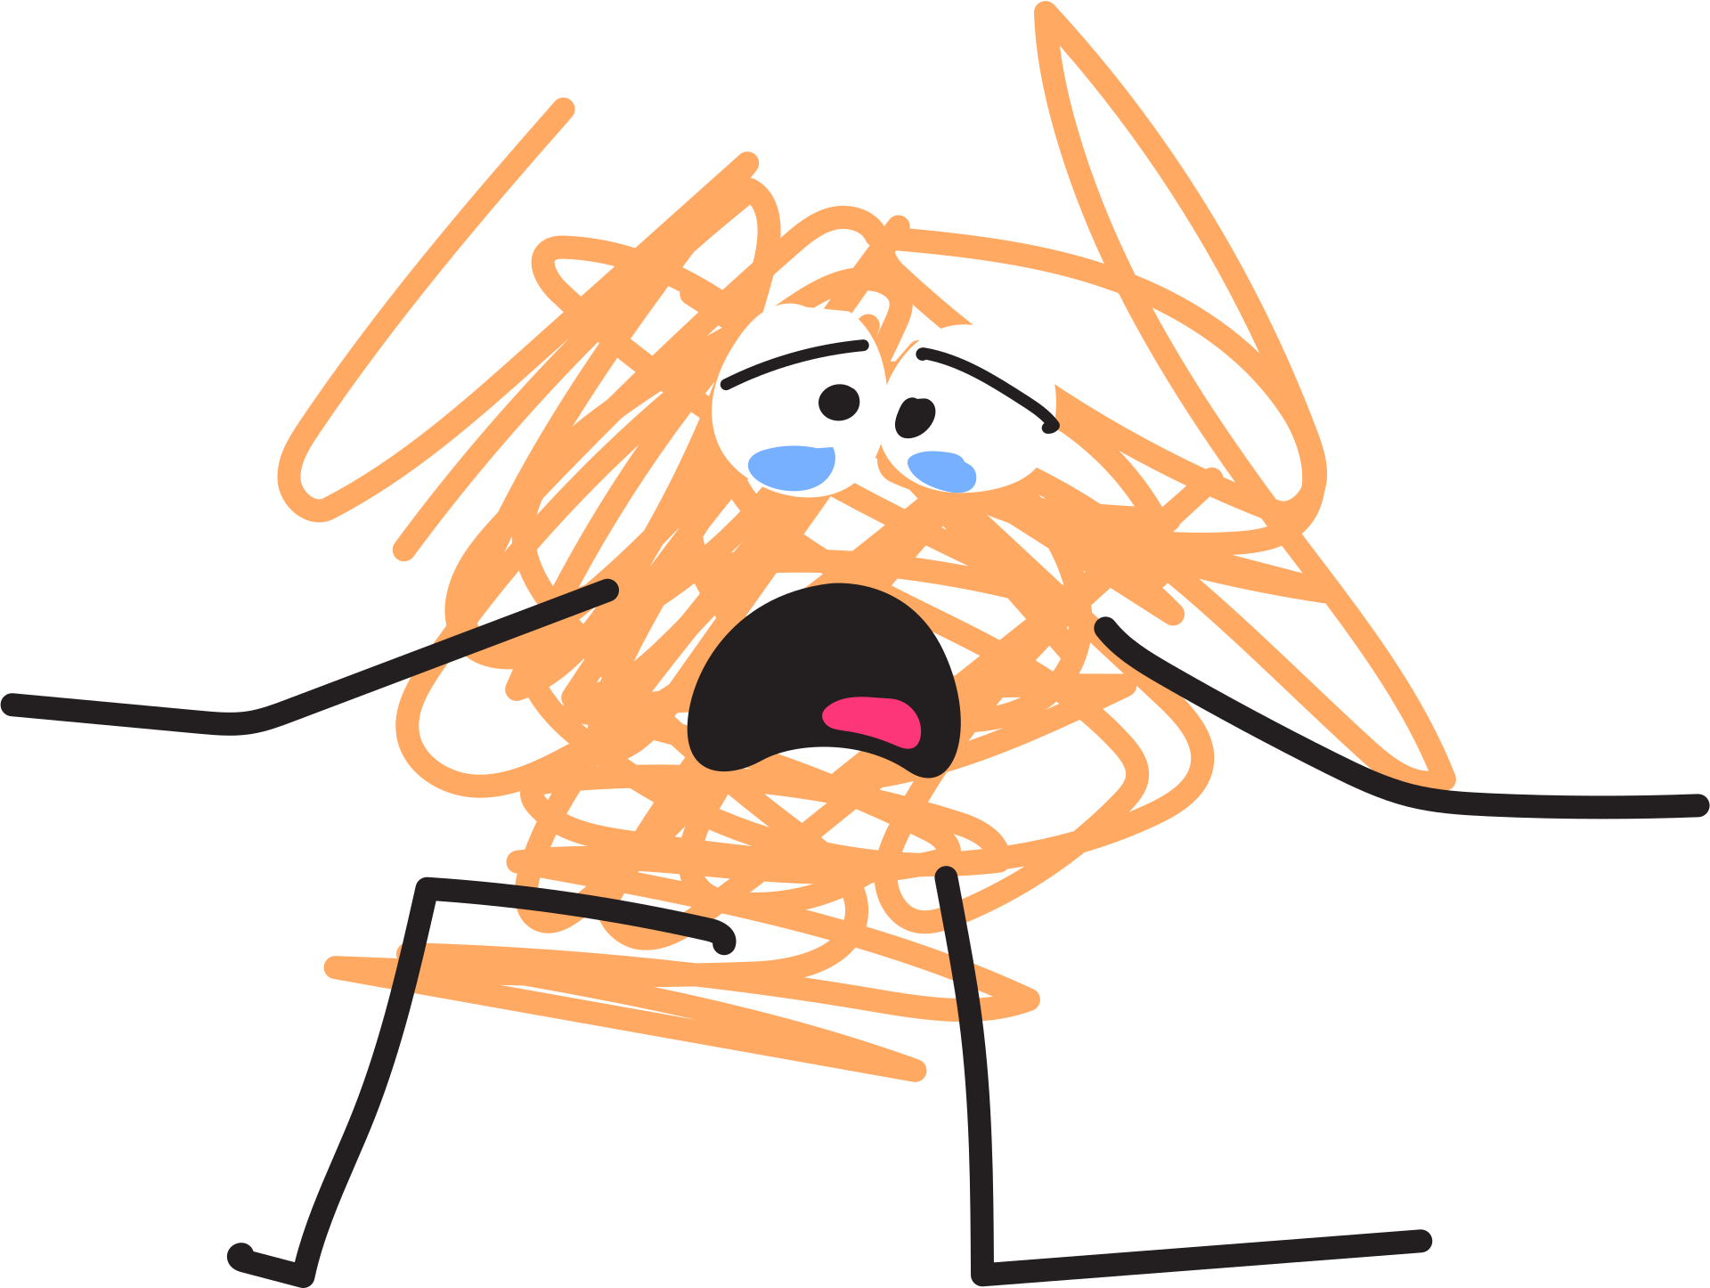
Day One
Good morning, Emotion Explorers!
Today, we will play 'Let’s Face It!' with the one and only Chip Chipperton and we will get to know feelings like embarrassment and frustration.
Today’s challenge: Can you notice one feeling you have before lunch today and name it? Whether it's a hangry, grumpy, or a silly feeling, or something in between, remember: naming your feeling is the first step to facing it!
©2026 Pencil Box Solutions

Slide 6

Let’s Face IT!
©2026 Pencil Box Solutions

Slide 7



Recommended
Read Alouds
by Saxton Freymann
by Diane Alber
by Britney Winn Lee
©2026 Pencil Box Solutions

Slide 8
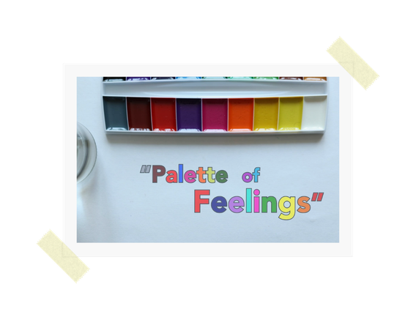
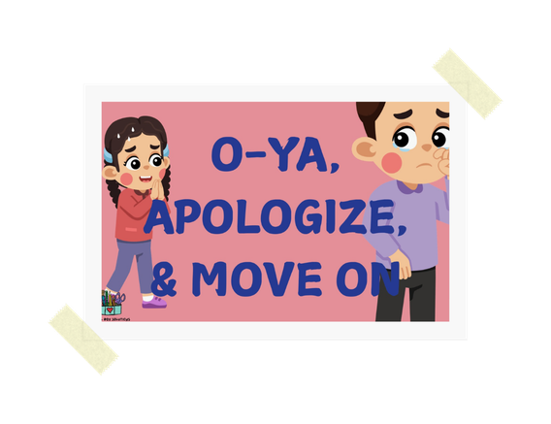

Need additional support?
FIX IT AND MOVE ON
PALETTE OF FEELINGS
ALL OF MY EMOTONS
Check out these videos on PBS website.
©2025 Pencil Box Solutions

Slide 9
A Warm Wind Blows
All students will circle up. There should be a designated spot on the circle for each student. One student (or the teacher) stands in the center. The one in the middle begins with a statement . . .
“A warm wind blows for . . . (fill in the blank)”
For example, “A warm wind blows for anyone who brushed their teeth this morning.” Then anyone who brushed their teeth has to move to find a new spot. Anyone who cannot find a spot, will be in the middle and must think of a true statement about themselves that will provide the next shuffle of spots.
Other examples: ate breakfast, wearing tennis shoes, has a dog, likes to read, has a sister, is an only child, etc.
©2026 Pencil Box Solutions

Slide 10
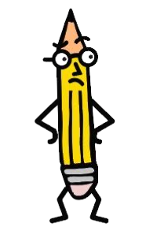
Week Two
Day Two
©2026 Pencil Box Solutions

Slide 11
Day Two
Good Morning Emotion Explorers!
Chip Chipperton would be proud—because today, YOU get to be the host of your own inner game show! When a big feeling shows up (even a weird or wobbly one), pause, take a breath, and say, 'Hey, I see you!'
That’s how we grow our brains and our hearts at the same time. You might feel a twisty tummy, a pounding heart, or a deep sigh coming on—that’s your body sending you a clue. Be a curious scientist about it! You don’t have to fix the feeling right away—just notice it, name it, and breathe. That’s how Emotional Explorers become champions. So, grab your metaphorical microphone and let the inner game show begin!
©2026 Pencil Box Solutions

Slide 12
Let’s Face IT!
Part 2
©2026 Pencil Box Solutions

Slide 13


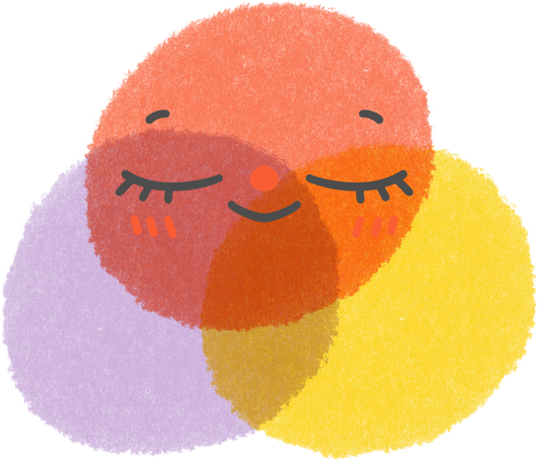



When you feel big or uncomfortable emotions
NOTICE
PBS
NAME
Pause
Breathe
Smile
©2026 Pencil Box Solutions

Slide 14


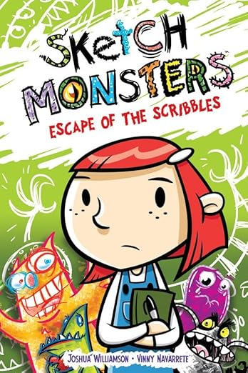
Recommended
Read Alouds
by Janan Cain
by Ganit & Adir Levy
by Joshua Williamson
©2025 Pencil Box Solutions

Slide 15
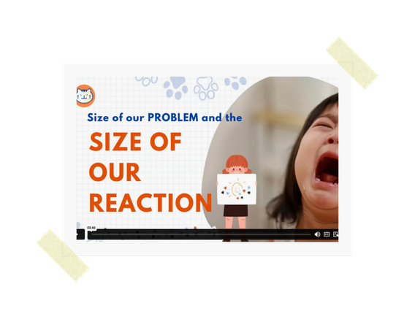

Need additional support?
Check out these videos on PBS website.
SIZE OF MY PROBLEM
ALL OF MY EMOTONS
4-7-8
©2026 Pencil Box Solutions

Slide 16
Caught Red Handed
For this activity, you’ll need Two or three (or more) small objects that can be easily passed around the circle, behind children’s backs. One person stands in the middle of the circle and closes his/her eyes for a moment. Children who are in the circle begin to pass the objects behind their backs, as sneakily as possible. They also pretend to pass objects so that at all times students are either passing an object or faking a pass. The person in the middle opens his/her eyes and tries to figure out where the objects are in the circle. The person has three guesses, which should be made quickly.
©2026 Pencil Box Solutions

Slide 17
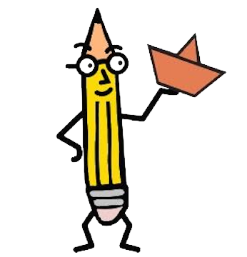
Week Two
Day Three
©2026 Pencil Box Solutions

Slide 18
Day Three
Chip Chipperton says the best players in the game show of life use their eyes to observe, brains to wonder, hearts to care, and voices to check in.
When someone frowns at us or turns away, we don’t have to assume the worst. We can pause, breathe, and smile. Their reaction probably has nothing to do with us. Being a Feelings Detective means we can wonder, but not judge. That’s how real emotional superheroes roll. So, gear up for the day, friends—let’s face it with heart and the SMACK DOWN episode of “Let’s Face It”!
©2026 Pencil Box Solutions

Slide 19

Let’s Face It:
Final Smack Down
Instead of guessing how someone feels, we can slow down and check in. Today, your challenge is to observe with your eyes, think with your brain, and care with your heart. Champions of Compassion always lead with kindness.
©2026 Pencil Box Solutions

Slide 20


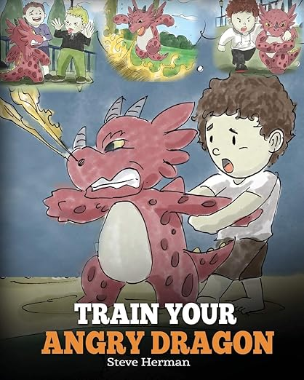
Recommended
Read Alouds
by Liz Haske
by Jane Manning
by Steve Herman
©2026 Pencil Box Solutions

Slide 21
Fruity McTooty
Each person in the circle names a piece of fruit, with no repeats. Then, covering teeth with lips, one child says his/her own fruit followed by another child’s fruit – for example, “apple, mango”. The child who initially named “mango” goes next, attempting to say “mango” plus the name of yet another child’s fruit without showing any teeth, and so on. It is very difficult for children not to laugh and show their teeth in this activity. Students who do show their teeth are out and just watch the action, which is almost as much fun. The goal is to try to remember the fruits of the others and try to be the last person standing.
**The activity can also be played with no definitive end by not calling individuals out; but you may want to start with a time limit so that it doesn’t go on too long. In addition, to being a lot of fun, this activity reinforces listening skills.
©2026 Pencil Box Solutions

Slide 22
Week Two
Day Four
©2026 Pencil Box Solutions

Slide 23
Day Four
Inside your body, there’s a stoplight that helps you know how you’re feeling. Green means calm and ready to go, yellow means slow down and notice, and red means you need a full stop and some care. None of the lights are bad—they’re just signals that help you understand yourself better. Today, try checking in with your light before you speak or act. Ask yourself: “What color of the stoplight am I right now?” And remember, no matter where you start, you can always use your tools to move back toward green.
©2026 Pencil Box Solutions

Slide 24
Your Body Is a STOPLIGHT
©2026 Pencil Box Solutions

Slide 25

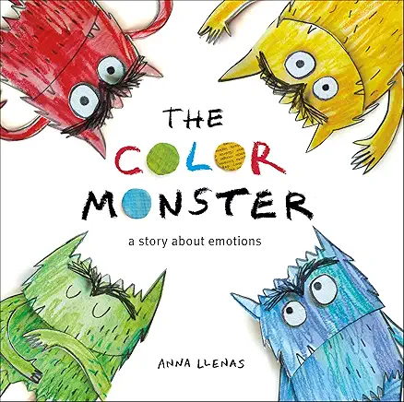

Recommended
Read Alouds
by Natalia Maguire
by Anna Llenas
by Dr. Seuss
©2026 Pencil Box Solutions

Slide 26


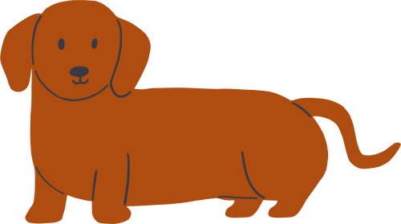
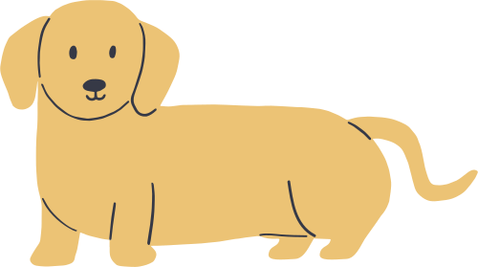
Red Light, Green Light, Corndog Style
There’s traditional “Red Light, Green Light,” but then there’s Corndog Style!
In this game you will need Two small stuffed animals. Divide the class into Two teams, each team tries to capture their own puppy from the dog pound. (Use Two chairs each with a small stuffed animal, like a Beanie Babies). The goal is to work in silence with your team to rescue your dog from the dog pound, without being caught by the stoplight.
continued
©2026 Pencil Box Solutions

Slide 27
Red Light, Green Light, Corndog Style
continued
The class lines up opposite “the Stoplight” who turns their back to the class, and says, “Green Light.” The class quietly and slowly tries to approach the “dog pound”, but at any time the stoplight can turn around and say “Red Light” and the teams must stop. Anyone caught moving has to go back to the start. The first team to get their team dog back to the start without getting caught wins and can have someone from their team be the next “Stoplight”. This game has no end, but try to end before the game feels over!
©2026 Pencil Box Solutions

Slide 28

Week Two
Day Five
©2026 Pencil Box Solutions

Slide 29
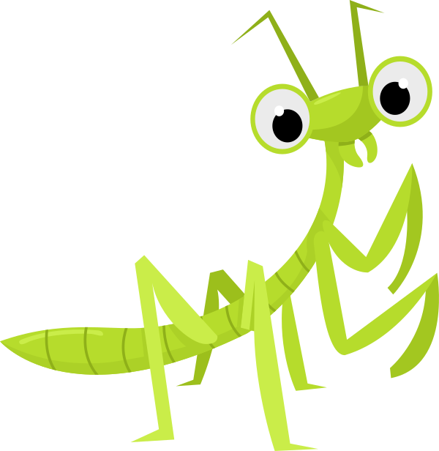
Day Five
Good morning, Bug Spotters! 🐞
Today we learned that sometimes, big feelings sneak up on us like little bugs. There’s The Loud Bug, the Fairness Bug, and even the Hungry Bug! When we notice those feelings early, we can name them and choose a smart way to take care of ourselves. That might mean getting a drink, taking a breath, or asking for help. Let’s pay attention to what’s bugging us today so we can feel calm, focused, and ready to learn.
©2026 Pencil Box Solutions

Slide 30
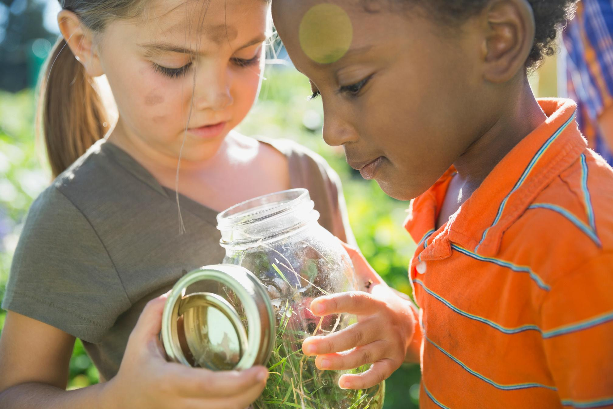
What’s Bugging You?
You might be feeling bugged or annoyed,
but what does that really mean?
©2026 Pencil Box Solutions

Slide 31



Recommended
Read Alouds
by Steve Metzger
by Jo Witek
by derek Munson
©2026 Pencil Box Solutions

Slide 32
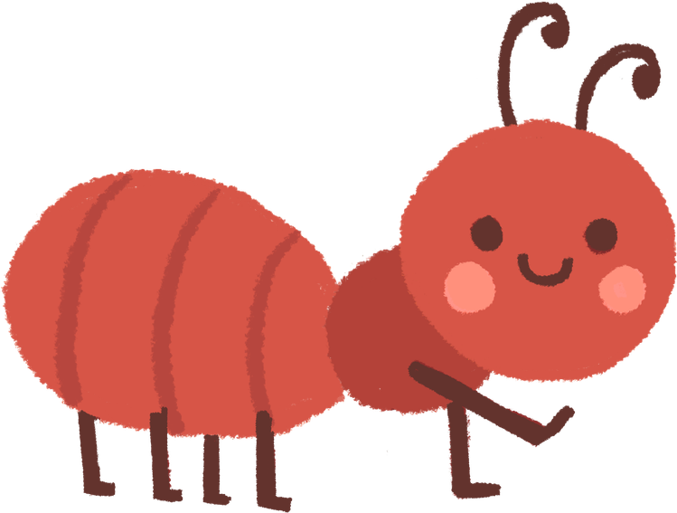


Find out what’s Bugging You
SYNTHESIS 1
anger - anxiety - sadness - loneliness
- feeling out of control -
negative self-talk - replaying bad or uncomfortable memories - rejection or abandonment - feeling invisible -
feeling criticized or judged - feeling like things are unfair -
loss or grief because someone isn’t in our life anymore -
Wow any audience with your Canva presentation. Design, plan and present all in one place.
SYNTHESIS 2
Wow any audience with your Canva presentation. Design, plan and present all in one place.
SYNTHESIS 3
Wow any audience with your Canva presentation. Design, plan and present all in one place.
©2026 Pencil Box Solutions

Slide 33
Common Threads
This game will require a little pre-planning. You will need to be able to quickly shuffle around and rearrange groups. There are many different websites that randomly generate groups of students for you. I prefer this one, (pickerwheel.com) but anyone will do. Input the names, and then select the number of groups based on the number in each group.
Brainstorm all the ways we can have something in common with others. Keep a list on the board (siblings, foods we like, games we play, clothing we are wearing, types of pets, etc. The more creative the better.)
Then spin the wheel and assign groups of 3. The students will find the other Two in their group. Then they have 30 seconds to find out what they have in common. Students keep track of their commonalities with others on their own using the honor system. Then randomly reshuffle and select teams of 4, 5, or 6. As you increase the number of students it will get increasingly more challenging, but it’s a great way to stretch the divergent thinkers! Once you get to 2 teams with half the class in each, you have one last challenge, and that is with the whole class. What do they all have in common?
©2026 Pencil Box Solutions

Slide 34

YOU DID IT!
WEEK Two
©2026 Pencil Box Solutions

