Slide 1



Morning Meeting Guide
Week Four
©2026 Pencil Box Solutions

Slide 2



Morning Meetings
Dear Friend,
If you’re feeling weary or discouraged, please remember this: your work matters greatly. Every moment you show up with patience, presence, and care , even when it feels unnoticed, you’re shaping the hearts and minds of our future. There’s a lot to navigate, and so much nuance to negotiate, but never fear: your steady effort leaves a lasting imprint.
If you can’t see the big wins today, start to notice the little ones, the quiet moments of connection, the “aha” glimmers, the student who feels seen because of you. Approach challenges with curiosity instead of judgment. Our best creativity and compassion unfold when our hearts are open.
You’ve got this. You are making a difference, more than you know.
Greta and the Pencil Box Team
©2026 Pencil Box Solutions

Slide 3
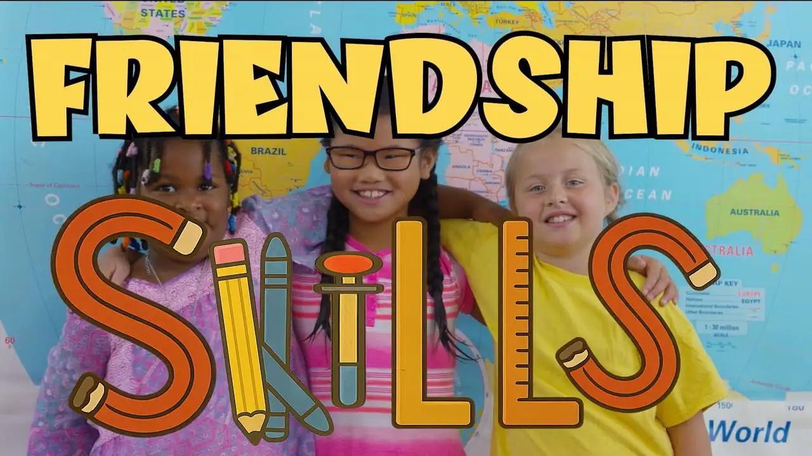
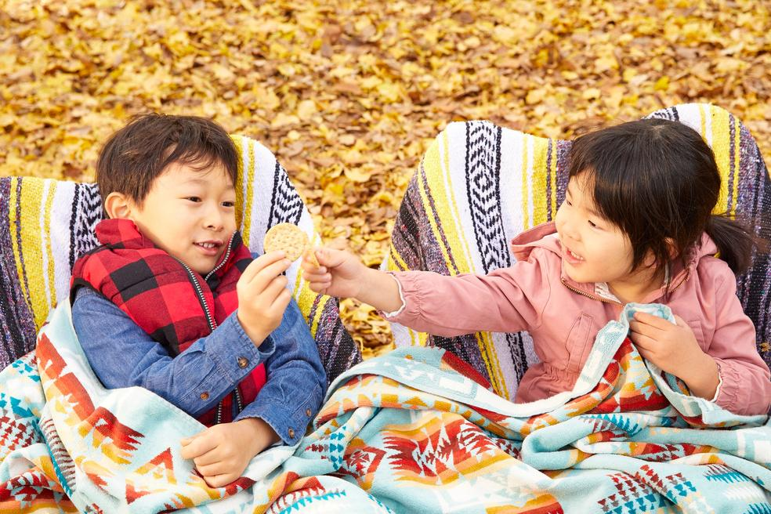



Week 4 Overview
Day 1
Day 2
Day 3
Day 5
What is Friendship?
Day 4
Taking Turns, Sharing, and Being Okay With Losing
How To Listen
OYA, Apologize, and Move On
Words Matter
©2026 Pencil Box Solutions

Slide 4
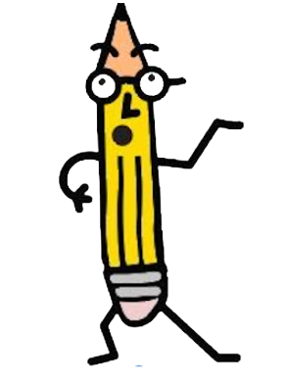
Week Four
Day One
©2026 Pencil Box Solutions

Slide 5
Day One
Good morning, everyone!
Today we’re going to learn about one of the most important parts of being human, friendship. Making friends can be easy, but keeping them strong and healthy takes kindness, honesty, and effort. Think about the kind of friend you want to have? Probably it’s someone who listens, tells the truth, and makes you feel safe. Now think about how you can be that kind of friend to others. When we practice kindness and curiosity, we help build friendships that can last a lifetime.
©2026 Pencil Box Solutions

Slide 6
What is Real Friendship?
©2026 Pencil Box Solutions

Slide 7
Cluster (version 1)
Have everyone spread out in a large open area, after you have given directions.
Explain that you will call out a number, and students will need to quickly form a group of that exact number of people.
If you yell out a number, for example, "Four!". Players must quickly find other people to form groups of that size (in this example, groups of four).
Leftovers: Anyone who doesn't find a group of the correct number is out and gathers next to the teacher to wait until the next number is called.
Continue by calling out different numbers.
©2026 Pencil Box Solutions

Slide 8



Recommended
Read Alouds
by Trudy Ludwig
by Derek Munson
by Beth Ferry
©2026 Pencil Box Solutions

Slide 9

Week Four
Day Two
©2026 Pencil Box Solutions

Slide 10
Day Two
Good morning, everyone!
Today we’re going to think about three important friendship skills that help our classroom feel safe and fun: taking turns, sharing, and being okay with losing. When we take turns, we show respect and make sure everyone gets a chance to be included. When we share, we discover that fun and creativity grow even bigger when we do things together. And when we lose, we get to practice kindness, patience, and good sportsmanship, the kind that lasts longer than any game. Each of these skills helps build trust and friendship, one small choice at a time. Let’s look for ways today to be fair players, generous sharers, and caring friends because that’s what makes our classroom community strong.
©2026 Pencil Box Solutions

Slide 11
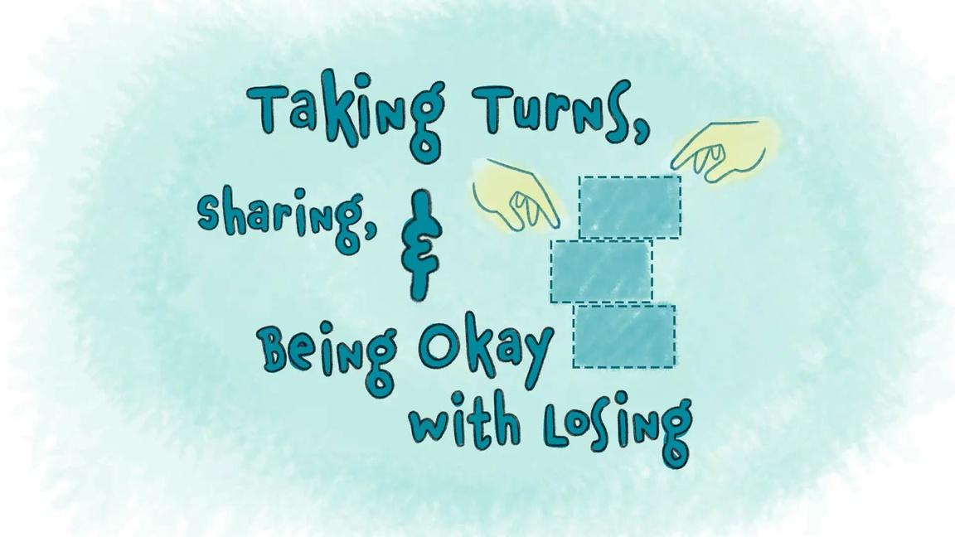
Taking Turns, Sharing,
and Being Okay With Losing
©2026 Pencil Box Solutions

Slide 12



Recommended
Read Alouds
by Marianne Blackstone Tabner
by Mo Willems
by Victoria Jamieson
©2026 Pencil Box Solutions

Slide 13
Cluster (version 2)
Have everyone spread out in a large open area, after you have given directions.
Explain that you will call out a number, and students will need to quickly form a group of that exact number of people.
If you yell out a number, for example, "Four!". Players must quickly find other people to form groups of that size (in this example, groups of four).
Leftovers: Anyone who doesn't find a group of the correct number is eliminated. They will now be responsible for demonstrating good sportsmanship. Students practice losing today because you can’t always win.
Continue by calling out different numbers. *Variation for older students: use math equations to solve the size of the group. Example 32/8=4, so students would get into groups of four.
©2026 Pencil Box Solutions

Slide 14

Week Four
Day Three
©2026 Pencil Box Solutions

Slide 15
Day Three
Good morning, everyone!
Have you ever been talking to someone and realized they weren’t really listening? Maybe they were looking at a screen, or thinking about something else. That never feels very good, does it? Today, we’re going to learn about how to really listen, not just with our ears, but with our whole body. That means our eyes are watching, our hands and feet are calm, our brain is focused, and our heart is open to care about what’s being said. When we listen with our whole body, we show others that they matter and that makes our classroom a kinder, safer, and stronger community.
©2026 Pencil Box Solutions

Slide 16
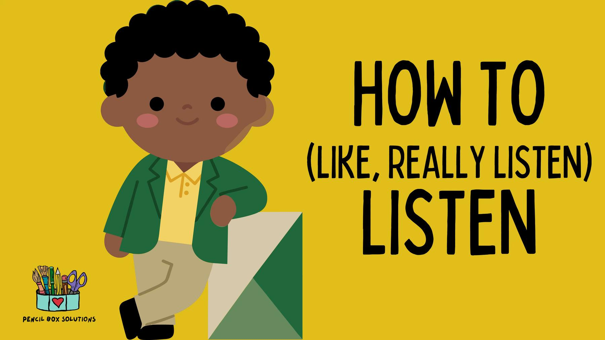
How to Listen, Like,
REALLY LISTEN
©2026 Pencil Box Solutions

Slide 17

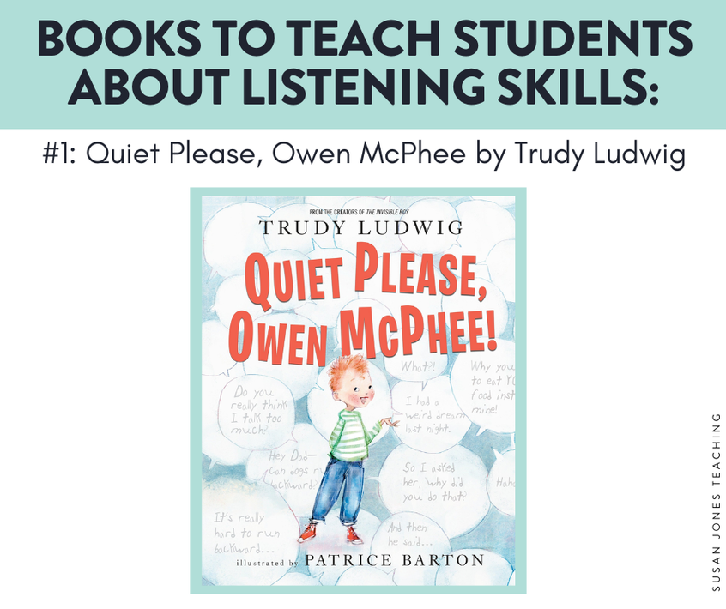

Recommended
Read Alouds
by Cori Doerrfeld
by Huynh, Sautter, & Wilson
by Trudy Ludwig
©2026 Pencil Box Solutions

Slide 18
(everyone version)
Activity: Telephone
Players must sit in a circle or stand in a straight line. They need to be close enough that whispering is possible, but not so close that players can hear each other whisper.
The first person in the line or circle whispers a word or phrase into the ear of the person sitting or standing to their right.
The Game Continues. Players whisper the phrase to their neighbors until it reaches the last player in line.
The last player says the word or phrase out loud so everyone can hear how much it has changed from the first whisper at the beginning of the circle or line.
©2026 Pencil Box Solutions

Slide 19
(everyone version)
Activity: Telephone
Telephone game words work well for younger players.
Words should be fairly long and open to misinterpretation.
Vocabulary needing to be introduced works well, too.
Some examples of telephone game words are:
• Manipulation
• Anticipation
• Regulator
• Proposition
• Incredible
• Courageous
• Triumphant
• Additional
©2026 Pencil Box Solutions

Slide 20
(upper elementary version)
Activity: Telephone
Begin with the basic version first, then add a variation.
Variations:
Team Telephone Game The Telephone Game works as a team game, especially if you have a large group. Give both teams the same word or phrase, or let them choose one of their own. The winning team is the one with the ending word or phrase closest to the original.
Rumors Rumors is a version of the telephone game where players deliberately change one or two words of the phrase. Rumors is also known as Gossip.
©2026 Pencil Box Solutions

Slide 21
Activity: Telephone
(upper elementary version)
Good Telephone Game sentences include famous quotes, or sentences containing multiple numbers and colors.
Remember that a Telephone Game sentence should be fairly easy to misinterpret. Also, try to use sentences with alliteration.
• Two tiny toads ate fat flying flies.
• The funny bunny hid the colored candy in the colored can.
• The queen sat on her throne and ate thorny kumquats.
• Many maids mop motels.
• Dogs dig holes for big bones.
• A bunch of yellow bananas launched on a blue boat.
• Twelve tumbling purple people pulled turnips.
©2026 Pencil Box Solutions

Slide 22
Week Four
Day Four
©2026 Pencil Box Solutions

Slide 23
Day Four
Good morning, everyone!
Today we’re going to think about something small that makes a big difference and that is our words. Words can lift people up or tear them down, and we get to choose which kind we use. Kind and encouraging words can make someone feel strong, noticed, and included. Hurtful words can do the opposite, they can stick and sting, even long after they’re spoken. When we use our words to help, include, and cheer others on, we make our classroom and our world a better place. Let’s look for ways today to surprise someone with kindness, not because we have to, but because we can.
©2026 Pencil Box Solutions

Slide 24
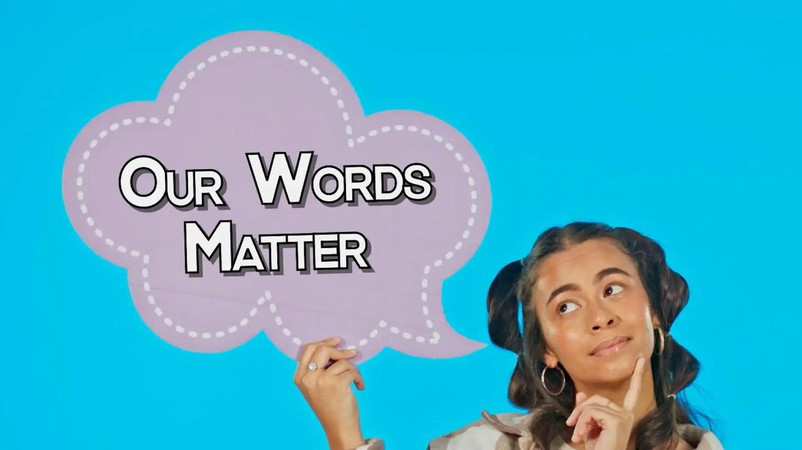
Our Words
Matter
©2026 Pencil Box Solutions

Slide 25



Recommended
Read Alouds
by Michael Genhart
by Julia Cook
by Bonnie Clark
©2026 Pencil Box Solutions

Slide 26
Activity: Hula Hoop Pass
Divide the group into small groups of approximately 10 kids. Have the group form a circle holding hands. Ask two students to be the starters, they will let go of their grip so you can place their hands through a hula hoop before rejoining them. They must work with the person next to them to pass the hula hoop around the circle in a specified direction until it returns to the starting point.
Another way to play is to use 2 loops of yarn or rope and have them go around the circle in opposite directions. (Yarn or rope should be about hula hoop size).
Take away Lesson: We are all connected. Kindness can spread, but it requires patience and ability to apologize and move on if we have hurt someone.
©2026 Pencil Box Solutions

Slide 27

Week Four
Day Five
©2025 Pencil Box Solutions

Slide 28
Day Five
Good morning, friends!
Today we’re going to talk about something that everyone, yes, everyone, has to face sometimes: what to do when we mess up. Nobody’s perfect, and mistakes happen every single day. What matters most is what we do next. When we take responsibility for our choices, say a real apology, and try to make things right, we show courage, honesty, and care for others. Owning our actions builds trust, and trust builds stronger friendships and a safer classroom. So today, let’s practice being brave enough to say, “I messed up,” kind enough to say, “I’m sorry,” and strong enough to make it right.
©2026 Pencil Box Solutions

Slide 29
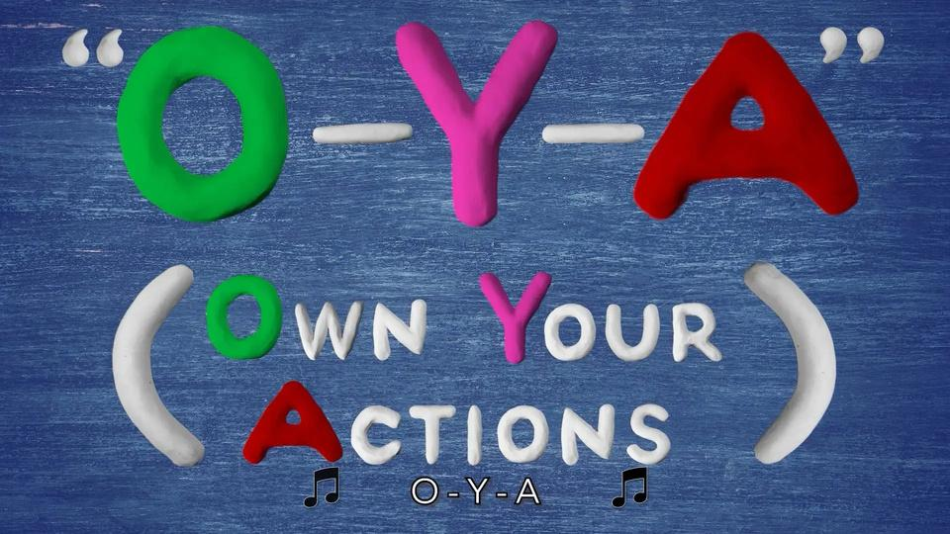

Double Feature!
O-Y-A
O-Ya, Apologize,
and Move On!
©2026 Pencil Box Solutions

Slide 30



Recommended
Read Alouds
by Lauren Thompson
by David LaRochelle
by Joyce Sidman
©2026 Pencil Box Solutions

Slide 31
Follow My Lead Drawing
Place students in pairs, one facing you and the other facing in the opposite direction with a piece of paper and a pencil.
Next, tell your students that you are going to show a simple picture to the students facing you. After they’ve had 15 seconds to look at it, you will hide it (but don’t erase it).
Once you say “go,” they’ll have one minute to describe the image to their partner in as much detail as possible. At the end of the minute, the drawing students will bring their pictures to the front of the room to compare them to the original. The drawings that are most similar can be deemed the “winners.” The process then repeats with the partners switching spots.
SYNTHESIS 1
Wow any audience with your Canva presentation. Design, plan and present all in one place.
SYNTHESIS 2
Wow any audience with your Canva presentation. Design, plan and present all in one place.
SYNTHESIS 3
Wow any audience with your Canva presentation. Design, plan and present all in one place.
©2026 Pencil Box Solutions

Slide 32
Follow My Lead Drawing
(Quick tip: It works best to choose pictures that are simple to draw but have several details. Depending on the age of the students the more or less detail you add.)
  basic house with a chimney, 3 windows, 2 doors, and a tree with 9 apples & a squirrel
  A sailboat on an ocean, with a moon up above and 7 fish in the water, an island in the distance with a volcano and a palm tree.
SYNTHESIS 1
Wow any audience with your Canva presentation. Design, plan and present all in one place.
Although a lot of fun, this game can be frustrating, and that’s sort of the point. It can be challenging to try to describe something from memory. It can also be challenging to try to interpret what someone is describing to you and then draw it. Both team members have a responsibility to the other that they must try to meet. You can really enhance this concept by adding a reflection activity to the end of the game. Ask your students how it felt to be the describer or the drawer. Have them explain what frustrations they felt. Discuss appropriate ways to deal with any feelings of nervousness or fear that come from not doing a good job in either role.
SYNTHESIS 2
Wow any audience with your Canva presentation. Design, plan and present all in one place.
SYNTHESIS 3
Wow any audience with your Canva presentation. Design, plan and present all in one place.
©2026 Pencil Box Solutions

Slide 33

YOU DID IT!
WEEK FOUR
©2026 Pencil Box Solutions

