Slide 1

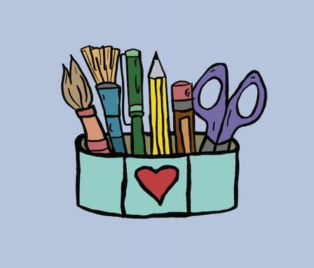
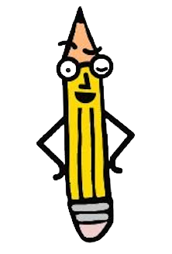
Morning Meeting Guide
Week Three
©2026 Pencil Box Solutions

Slide 2



Morning Meetings
Hey Friend,
You’ve laid the foundation, and now it’s time to equip your students with tools that help them notice and navigate big emotions. This week is all about self-regulation and helping students understand their inner signals, match the size of their reaction to the size of the problem, and discover ways to reset through movement, mindfulness, and safe spaces. These small steps build lifelong skills. You're not just teaching, you’re helping kids feel safe inside themselves. What a gift you are.
Greta and the Pencil Box Team
©2026 Pencil Box Solutions

Slide 3
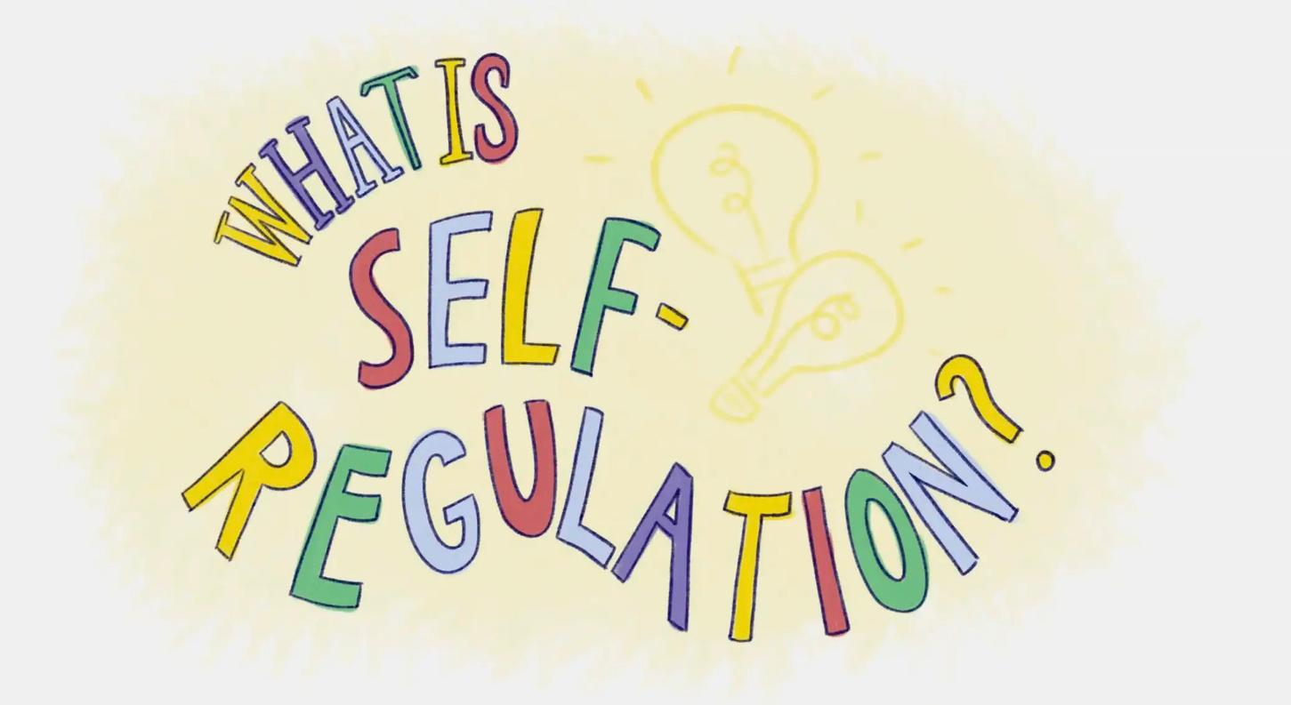

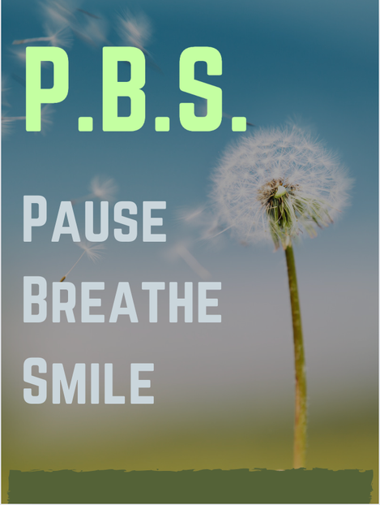
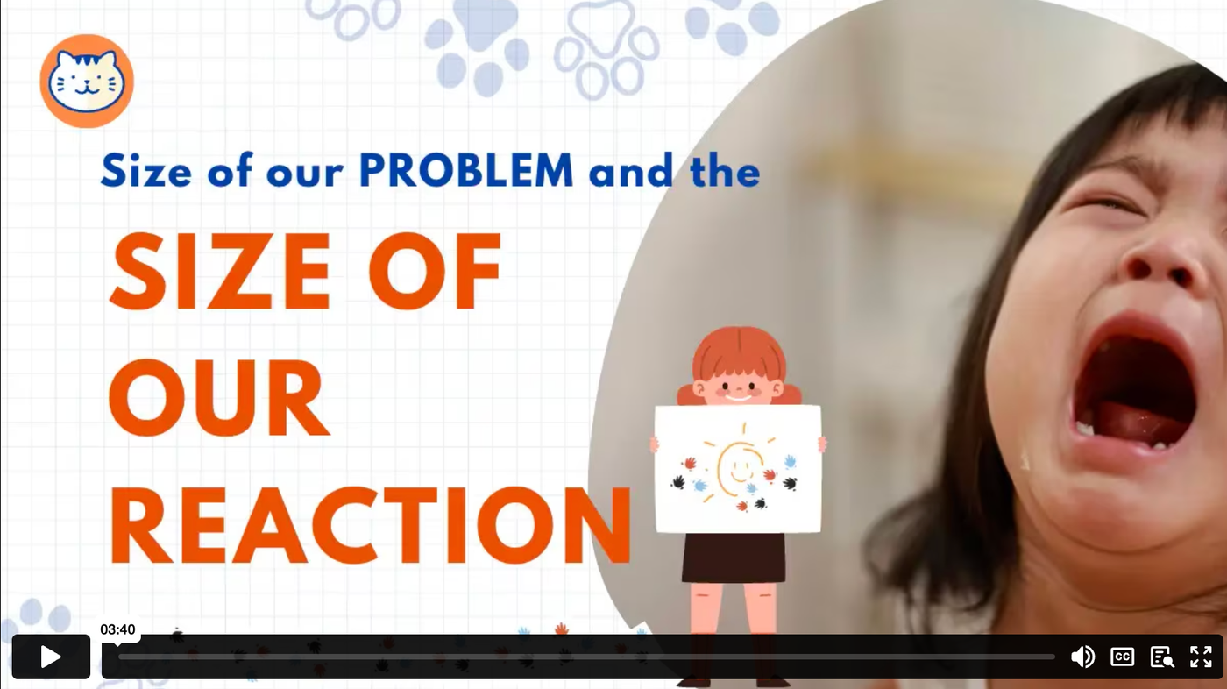

Week 3 Overview
Day 1
Day 3
Day 5
Day 2
Day 4
What is Self-Regulation?
Brain Breaks and
Movement
Calm Safe
Spaces
PBS
Pause, Breathe, Smile
Size of the Problem
Size of the Reaction
©2026 Pencil Box Solutions

Slide 4
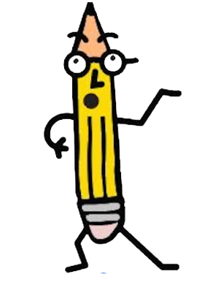
Week Three
Day One
©2026 Pencil Box Solutions

Slide 5

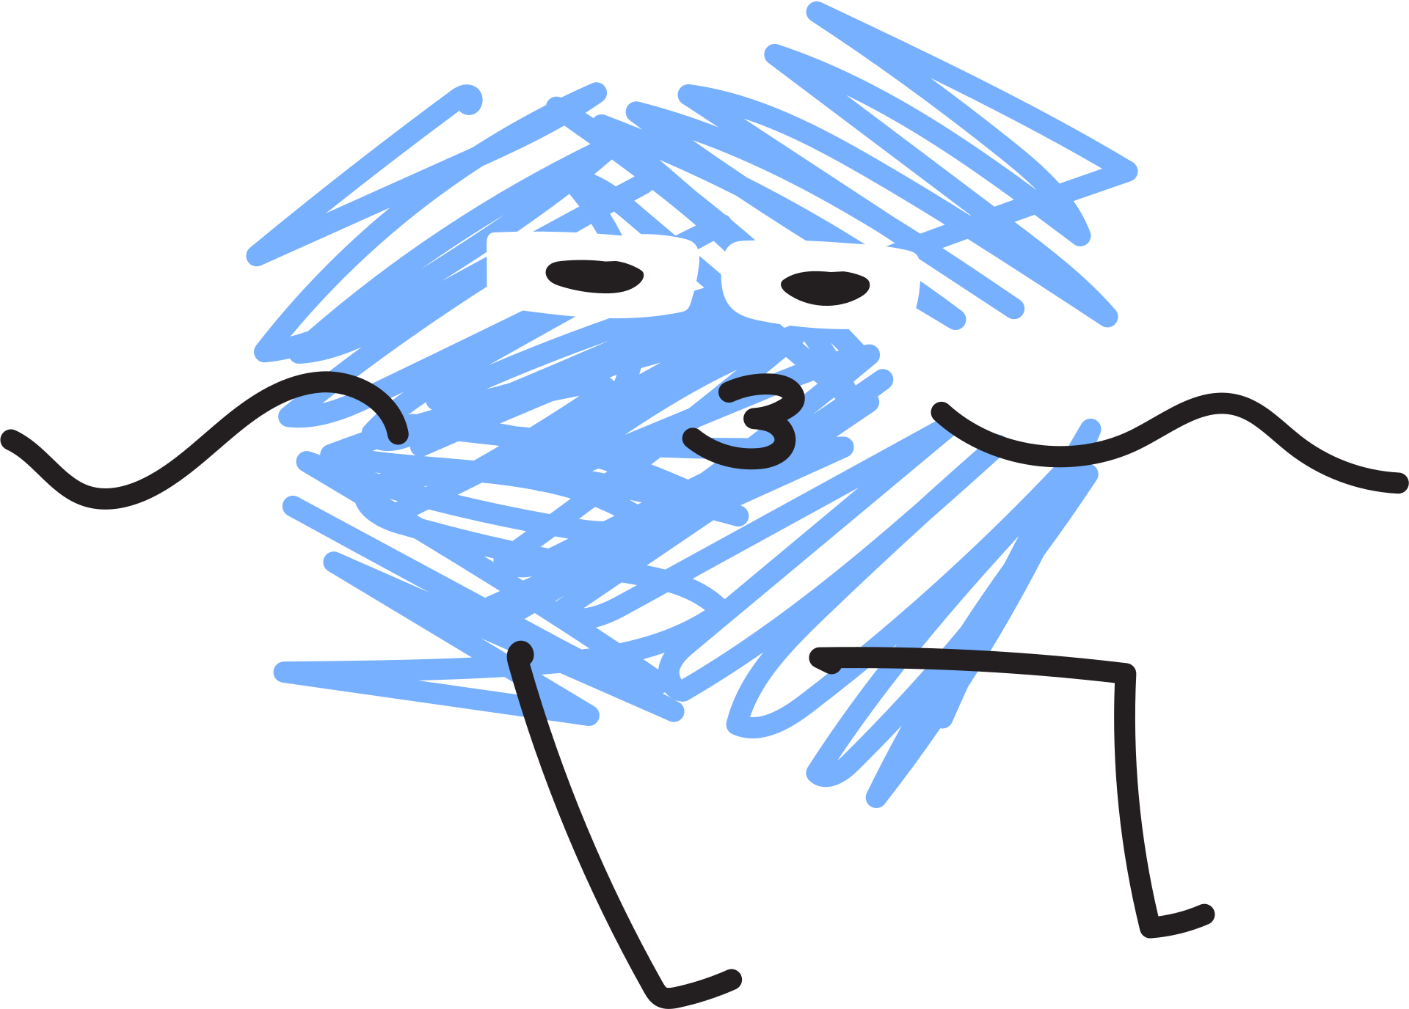
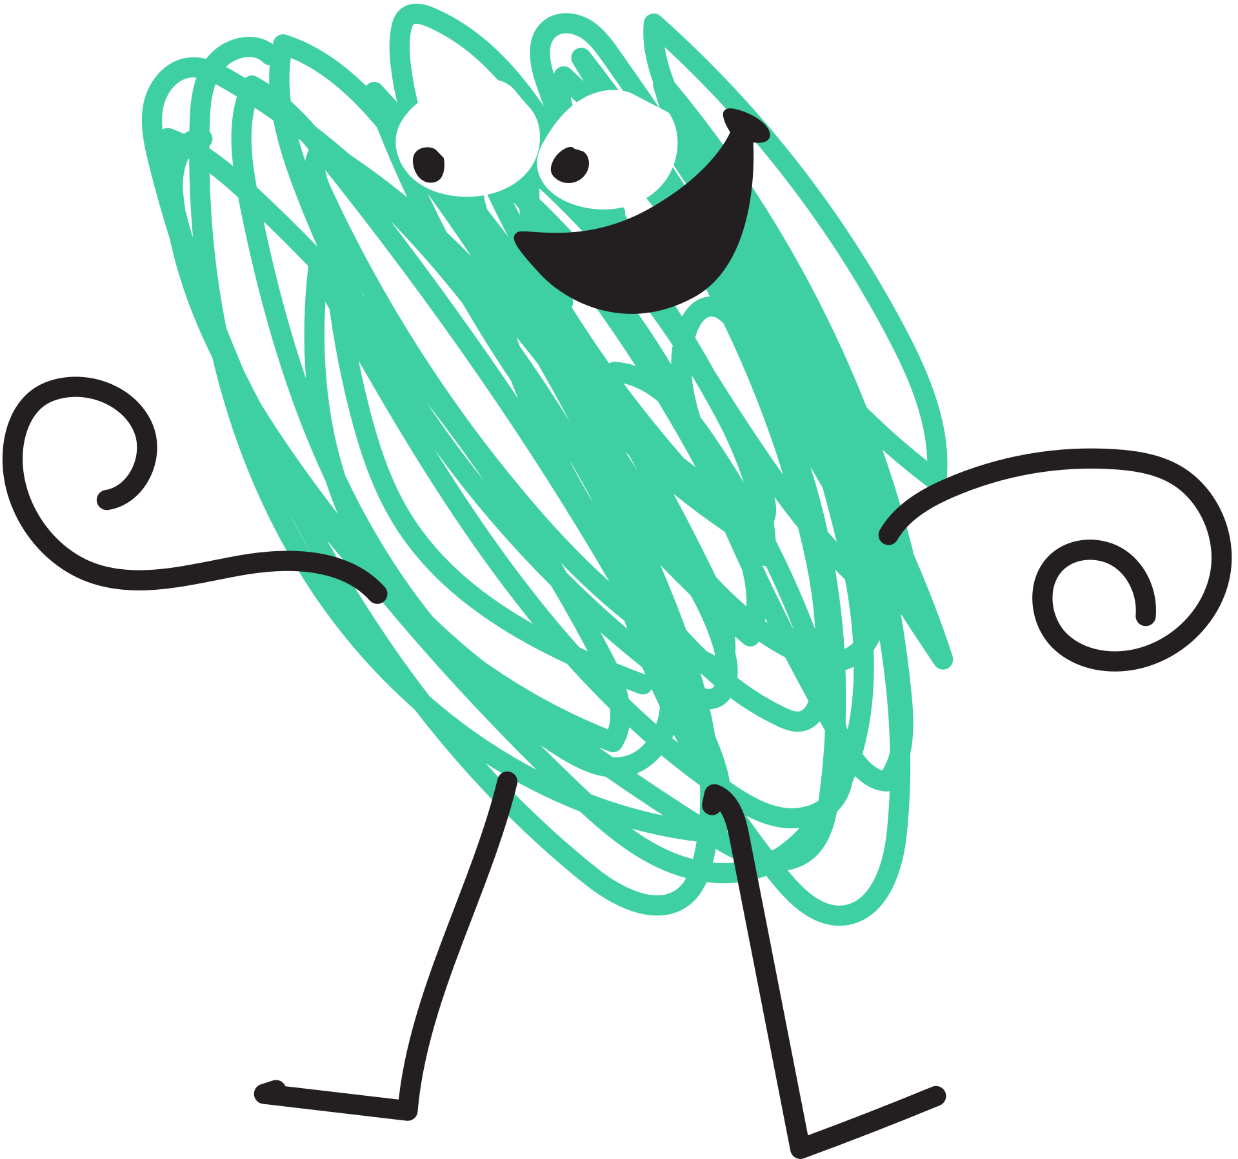
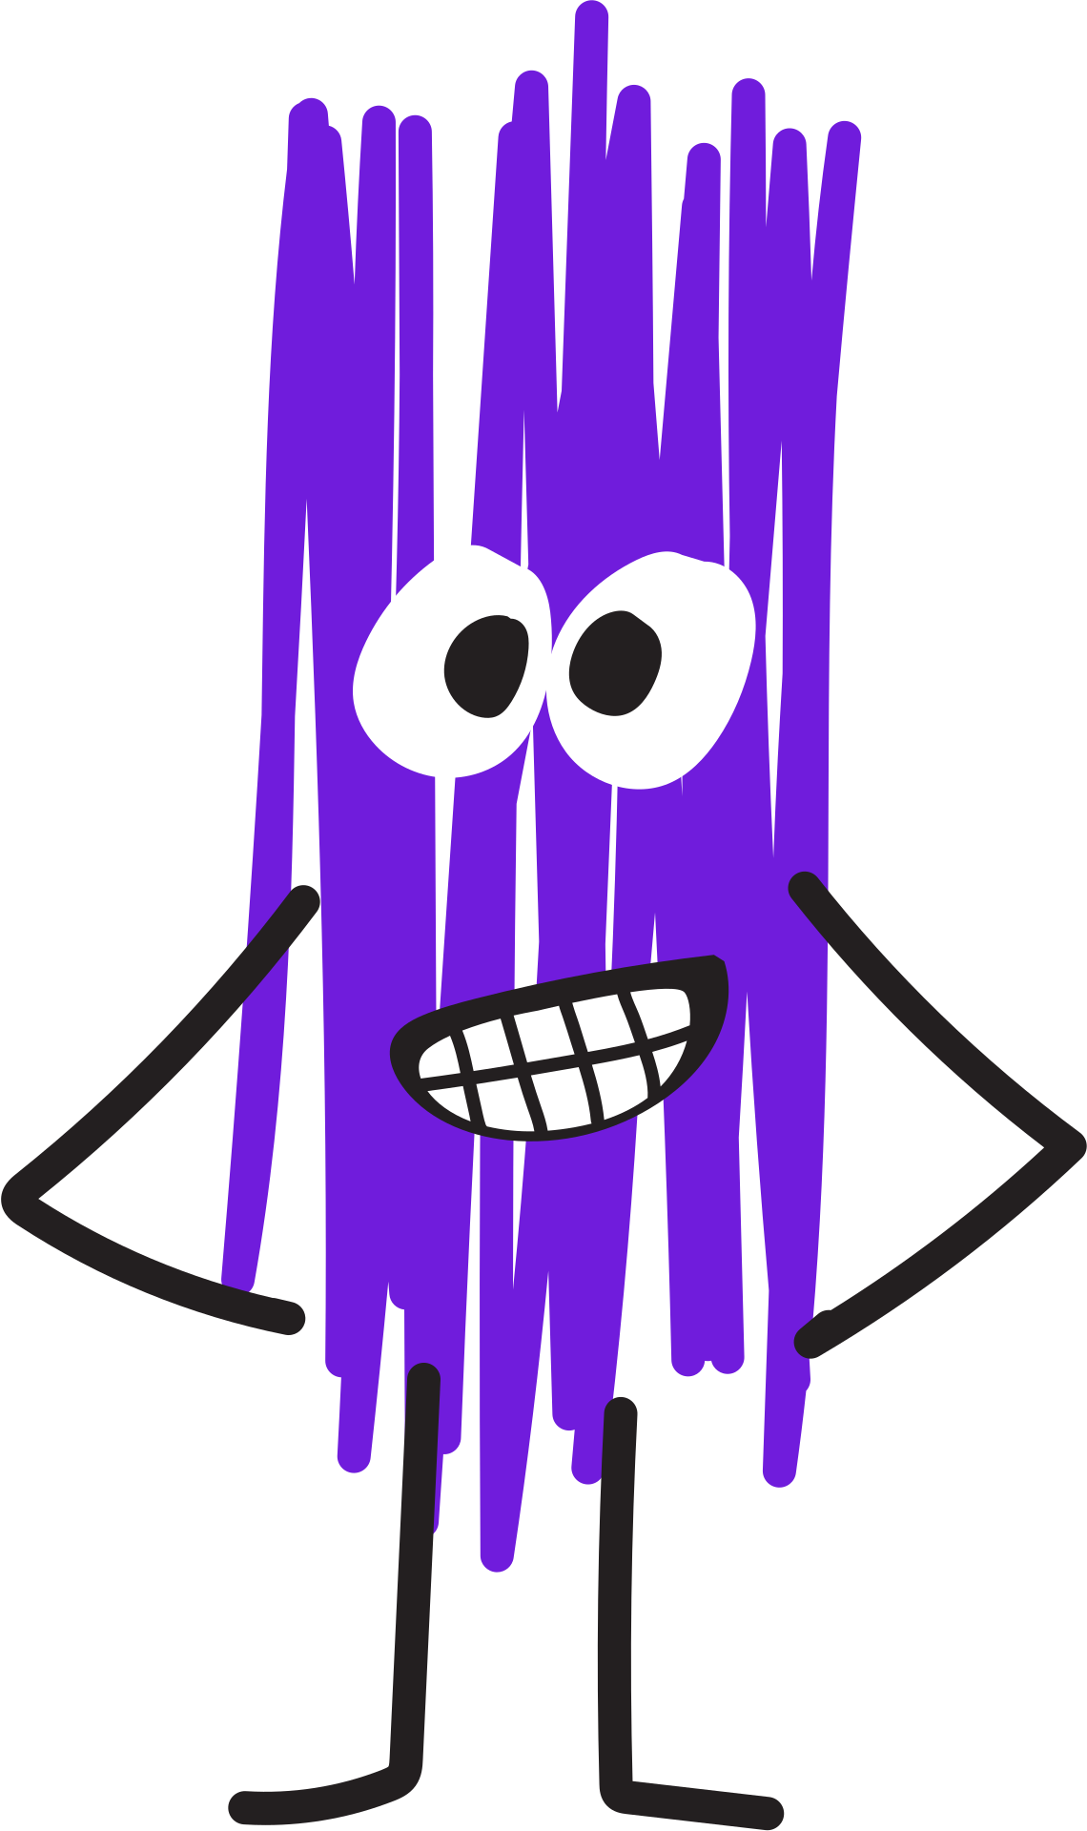
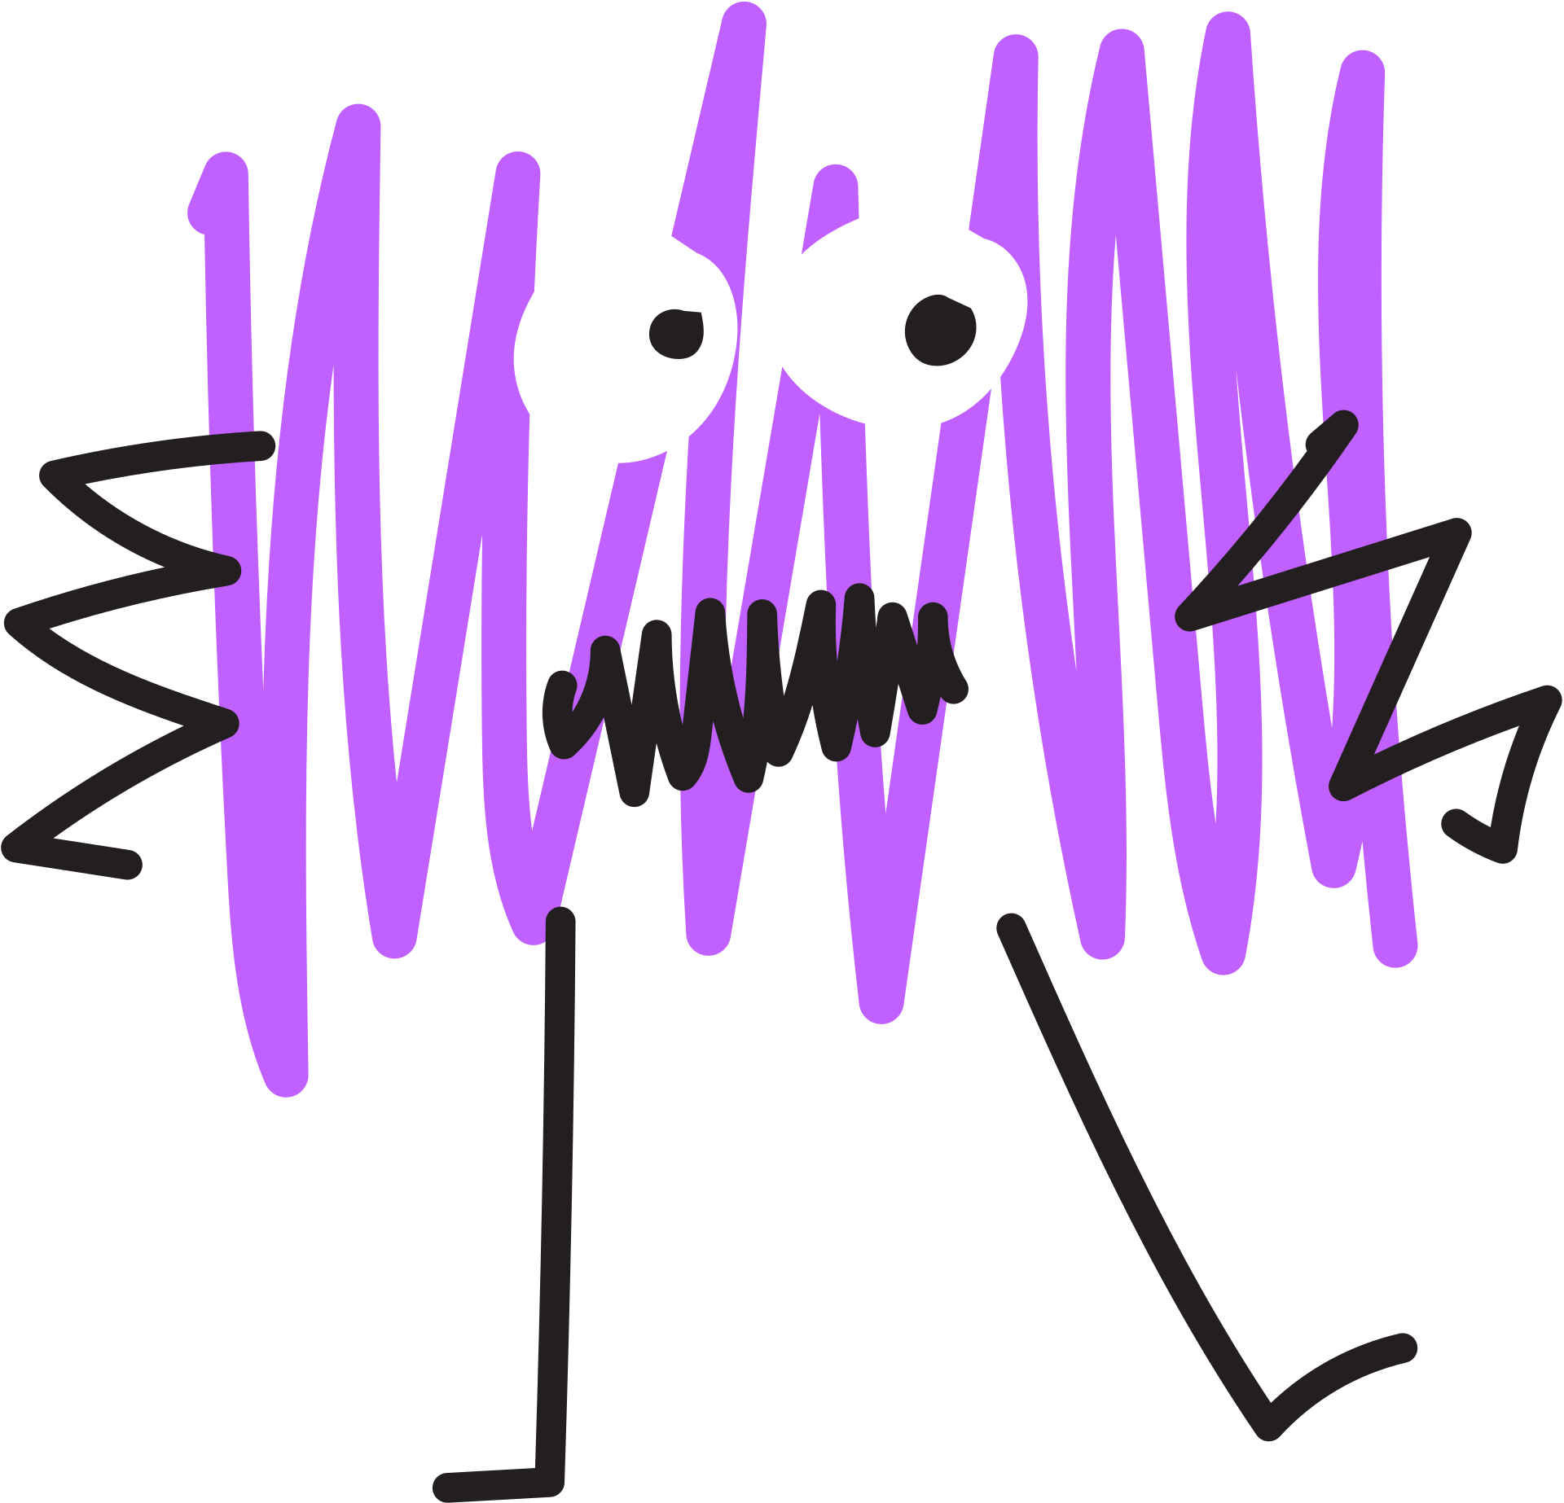
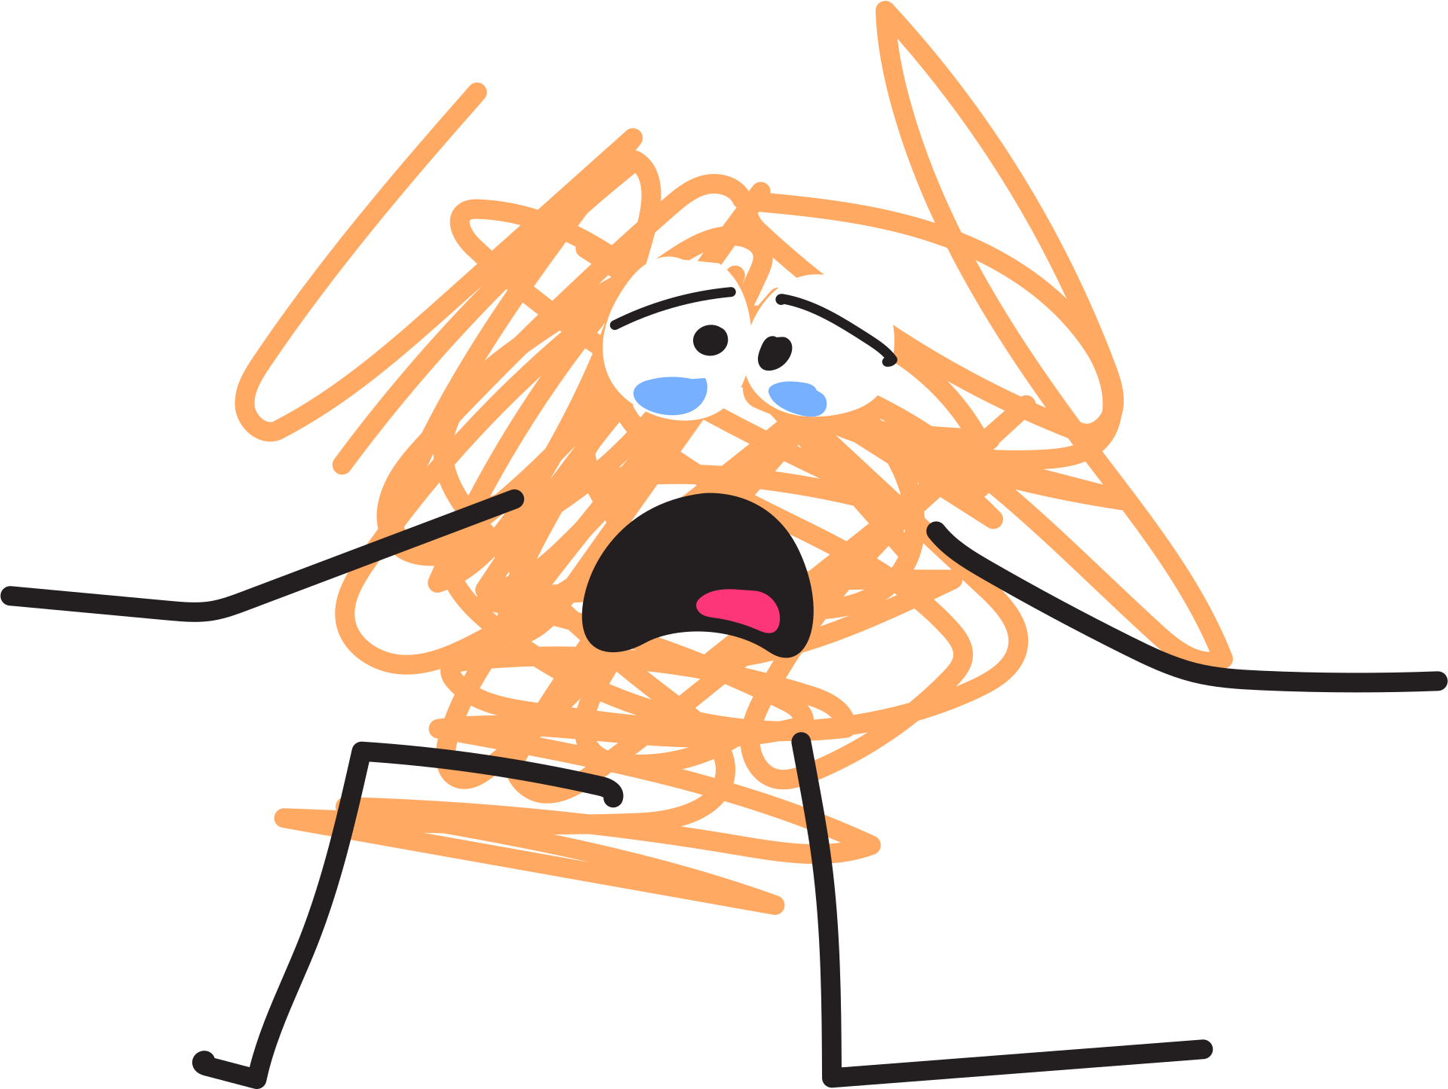
Day One
Hey, team!
Have you ever felt like your feelings were about to explode like a balloon? That’s called a big feeling and today, we’re going to learn how to notice those feelings before they pop! This is called self-regulation, and it’s like being a feelings detective. When we catch those feelings early, we can use tools, like breathing, stretching, or talking to help ourselves stay cool and calm. Let’s learn how to be in charge of our feelings instead of letting our feelings be in charge of us!
©2026 Pencil Box Solutions

Slide 6
What is Self-Regulation?
©2026 Pencil Box Solutions

Slide 7
Mirror, Mirror
You can vary this as you like, but start with the teacher as the leader. The goal is to be able to have the class “mirror” you. The game is done in silence and students try to do the opposite, if you raise your left arm, they raise their right, etc. Keep layering a variety of movements and motions. If someone talks or doesn’t follow along they are out. The new leader is selected from the last few remaining.
*An extra challenge with older students you can speak a simple sentence. They must say the sentence in reverse, or add more than one motion at a time.
Students always make this creative, so follow their lead.
©2026 Pencil Box Solutions

Slide 8



Recommended
Read Alouds
by Orlanda Bettison
by Molly Bang
by Shinsuke Yoshitake
©2026 Pencil Box Solutions

Slide 9
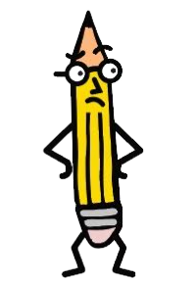
Week Three
Day Two
©2026 Pencil Box Solutions

Slide 10
Day Two
Good morning, problem solvers!
Imagine if we had a ruler to measure problems. A big problem might be all the way to the top of the ruler, and would be considered very serious and important. A small problem might only be a tiny mark at the bottom. Our goal is to make the size of our reactions fit the size of the problem. Today, we are going to talk about ways to measuring problems in our minds before we react. That way, we can save our big reactions for the big stuff—and keep our small problems small.
©2026 Pencil Box Solutions

Slide 11
Size of the Problem,
Size of the Reaction
©2026 Pencil Box Solutions

Slide 12

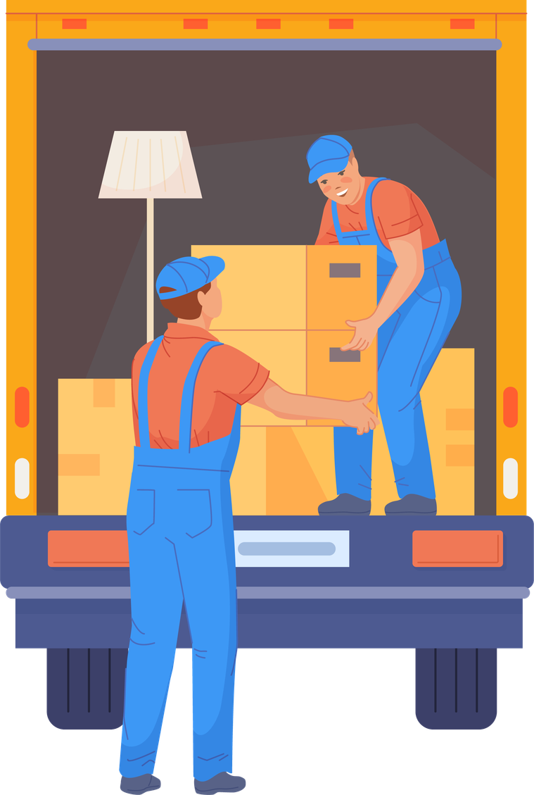
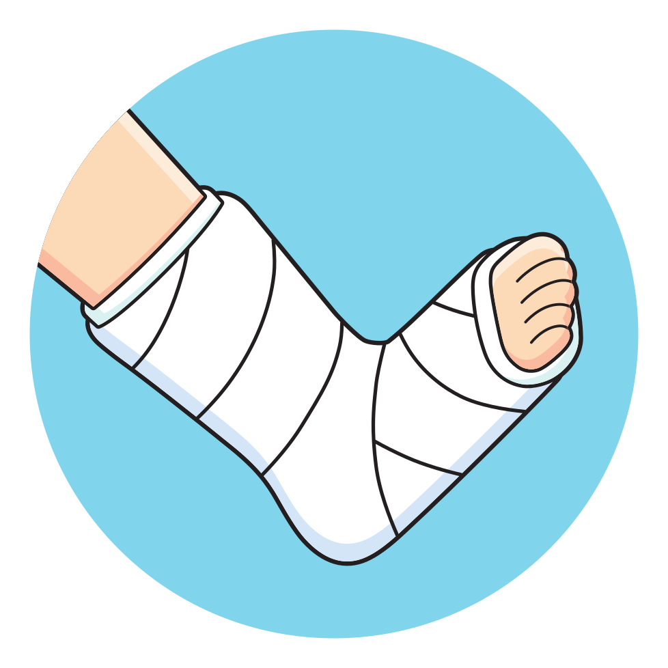

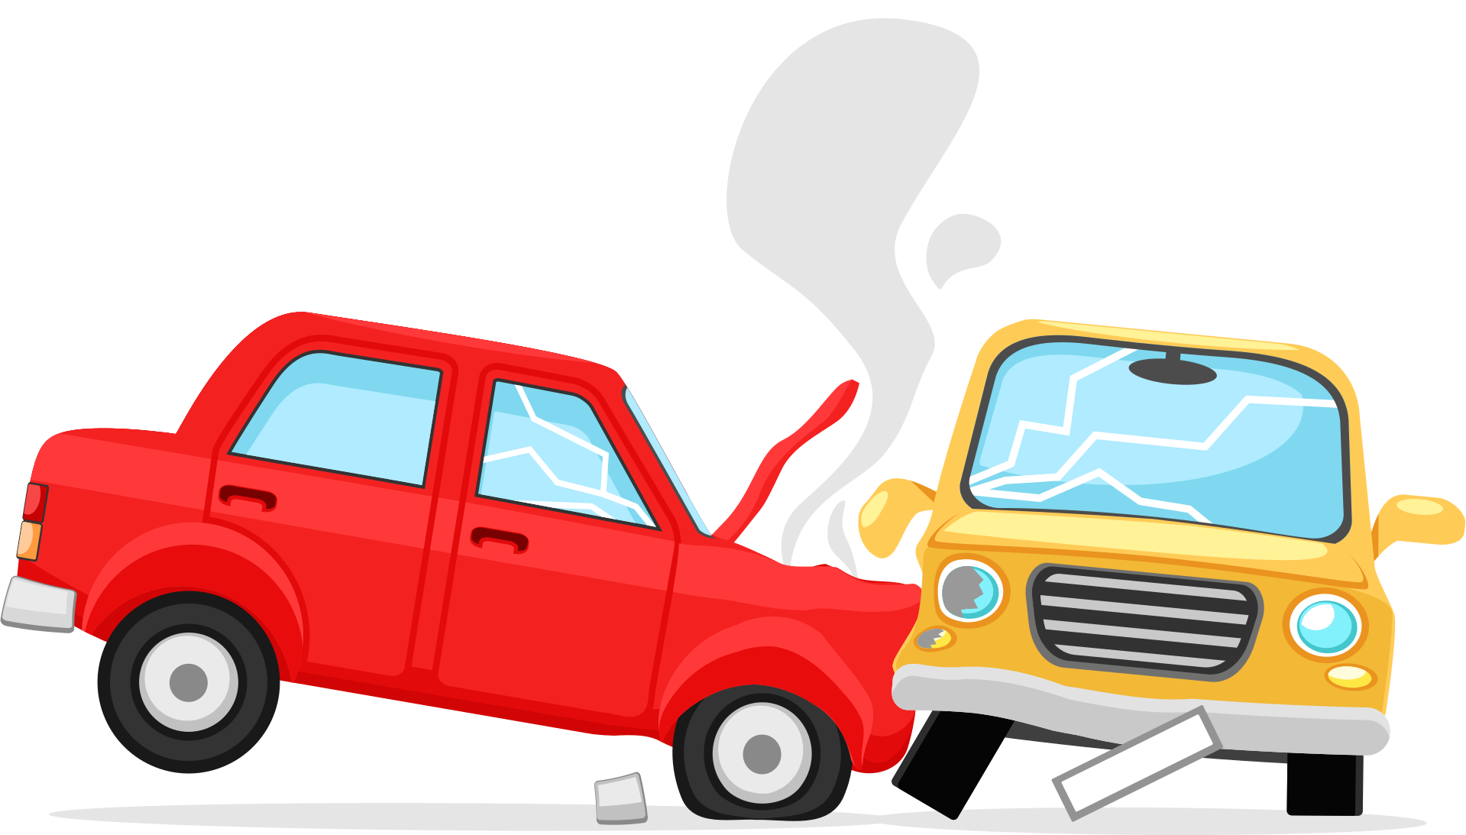
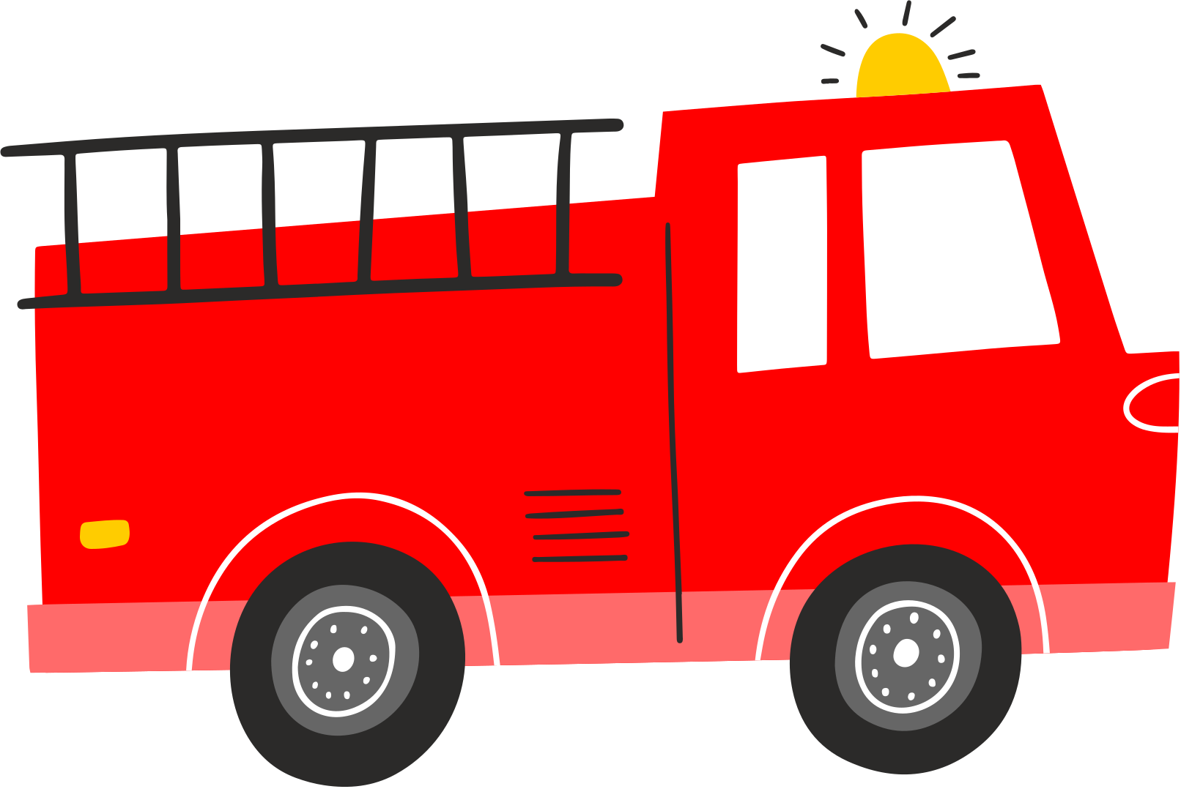
Examples of Big Problems
How many people does it take to solve a big problem?
How long does it take to solve?
What else do you notice about “Big Problems”?
©2026 Pencil Box Solutions

Slide 13
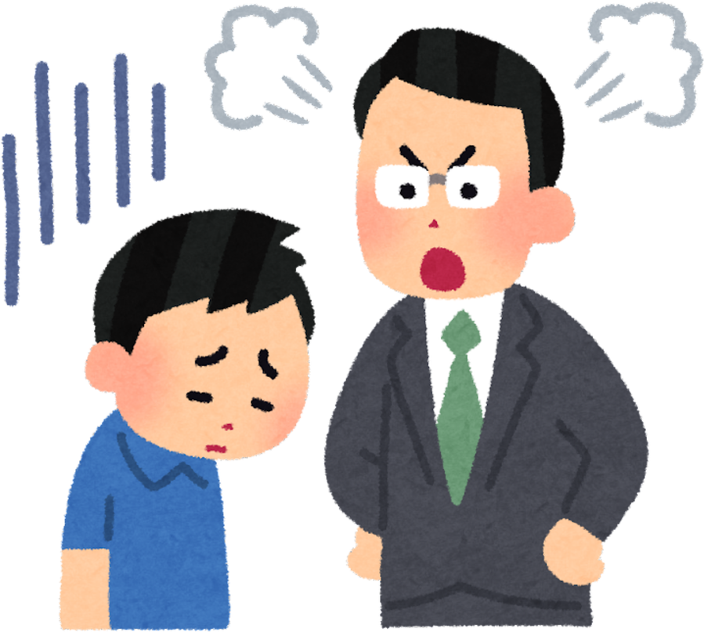




Examples of Small Problems
How many people does it take to solve a small problem?
What else do you notice about “Small Problems”?
  lost a game
  last in line
  time to clean up
How long does it take to solve a small problem?
forgot your lunch
©2026 Pencil Box Solutions

Slide 14


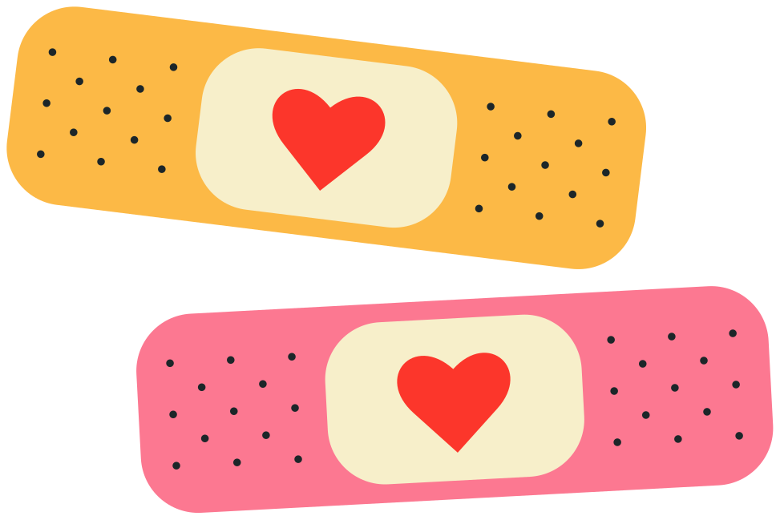
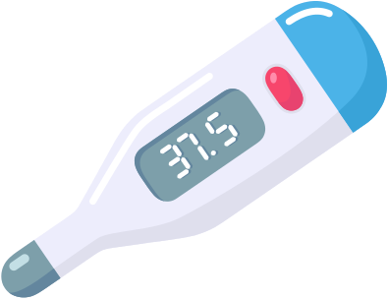
Examples of Medium Problems
How many people does it take to solve a medium problem?
What else do you notice about “medium sized Problems”?
What do you think would be a medium problem?
How long does it take to solve a medium sized problem?
©2026 Pencil Box Solutions

Slide 15
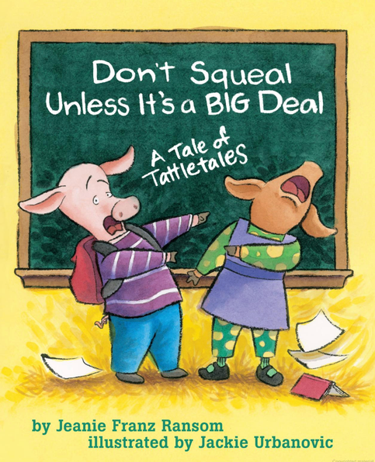
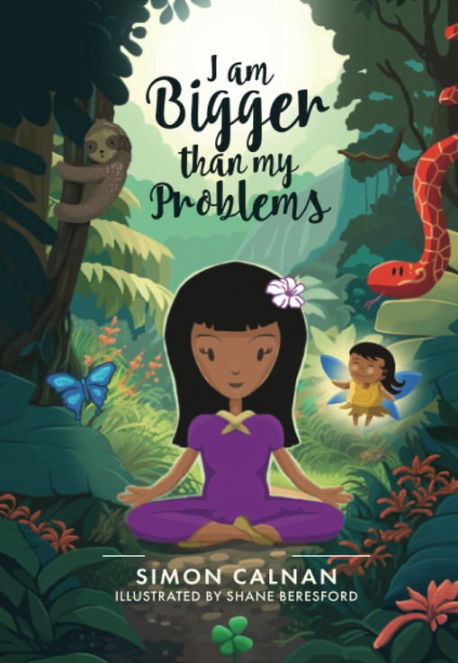
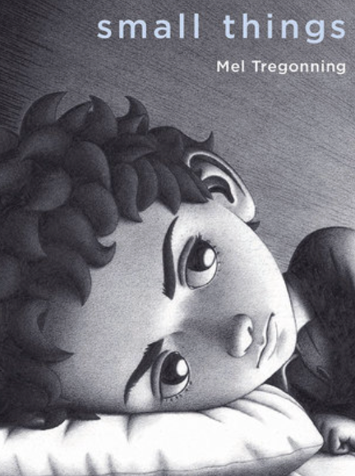
Recommended
Read Alouds
by Jeanie Franz Ransom
by Simon Calnan
by Mel Treggoning
©2026 Pencil Box Solutions

Slide 16
Human Sort with Size of Problem
Determine which side of the room will represent the “Big Problem”, the “Medium Sized Problem” will be in the middle, and the “Small Problem” will be on the opposite side of the room from the “Big Problem”.
The teacher or leader will read aloud a problem and the students will sort themselves accordingly. Similarly to “Four Corners” students will move to the area that they believe represents the size of the problem.
On the next slide read from a list of problems, one at a time. There is no “right or wrong” answer, just help students learn to nuance size of the problem and remind them the size of their reaction should match.
©2026 Pencil Box Solutions

Slide 17
Remember:
  The size of your reaction should fit the size of your problem.
  Our reactions are normal. We just want to build awareness as to the size of our problems, so we don’t get stuck feeling big feelins with little problems that can be easily solved.
  The bigger the problem the more time and people needed to solve it! (Little problems can be solved quickly by you!)
Problem Examples
  broke your pencil
  car breaks down
  sibling sent to the hospital
  someone was telling secrets about you
  you lost your field trip money
  forgot your lunch
  spilled paint
  lost library book
  dropped your lunch tray
  you had a fire at your house
  paper cut
  you were erasing your paper and it ripped
  bloody nose
©2026 Pencil Box Solutions

Slide 18
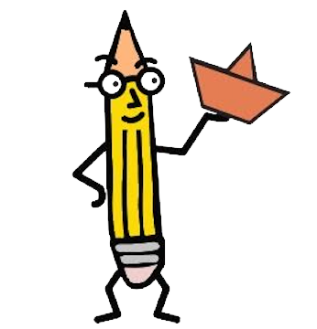
Week Three
Day Three
©2026 Pencil Box Solutions

Slide 19
Day Three
Good morning, Neuroscientists!
Neuroscientists study the brain and the nervous system! Big feelings don’t like to stay trapped inside because they need a way out. Mindful movement is like giving our feelings a safe path to travel. If we’re nervous, maybe we need a few deep breaths and shoulder rolls. If we’re frustrated, maybe we need to stretch or stand tall like a mountain. Today, we’ll practice noticing how we feel and choosing a “pathway” of movement that helps us get back to calm.
©2026 Pencil Box Solutions

Slide 20
Mindfulness
Journey
The Journey Begins Here
©2026 Pencil Box Solutions

Slide 21
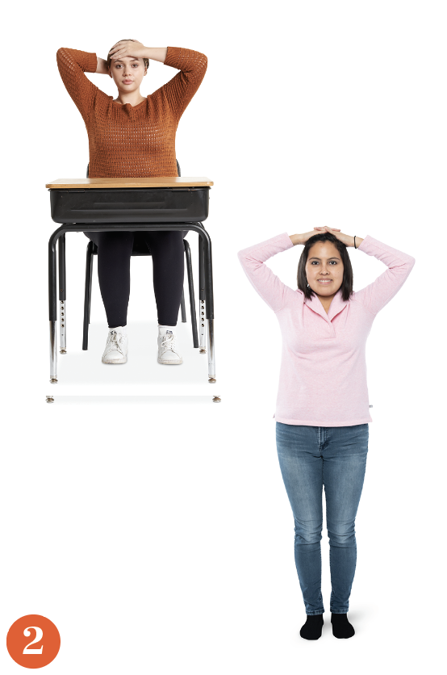
Let’s Face It:
Find a Path for all of our Emotions to move through our body.
©2026 Pencil Box Solutions

Slide 22


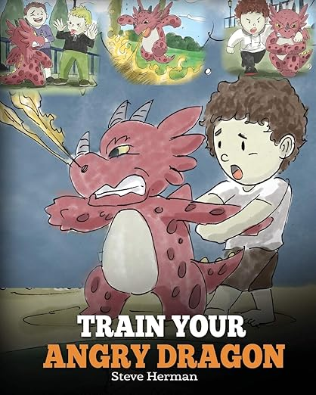
Recommended
Read Alouds
by Liz Haske
by Jane Manning
by Steve Herman
©2026 Pencil Box Solutions

Slide 23
Use the following slides when you are experiencing a particular emotion. The sequence of movements will help you reset.
*Remember to make your breath intentional, try the 4-7-8 while resetting.
©2026 Pencil Box Solutions

Slide 24

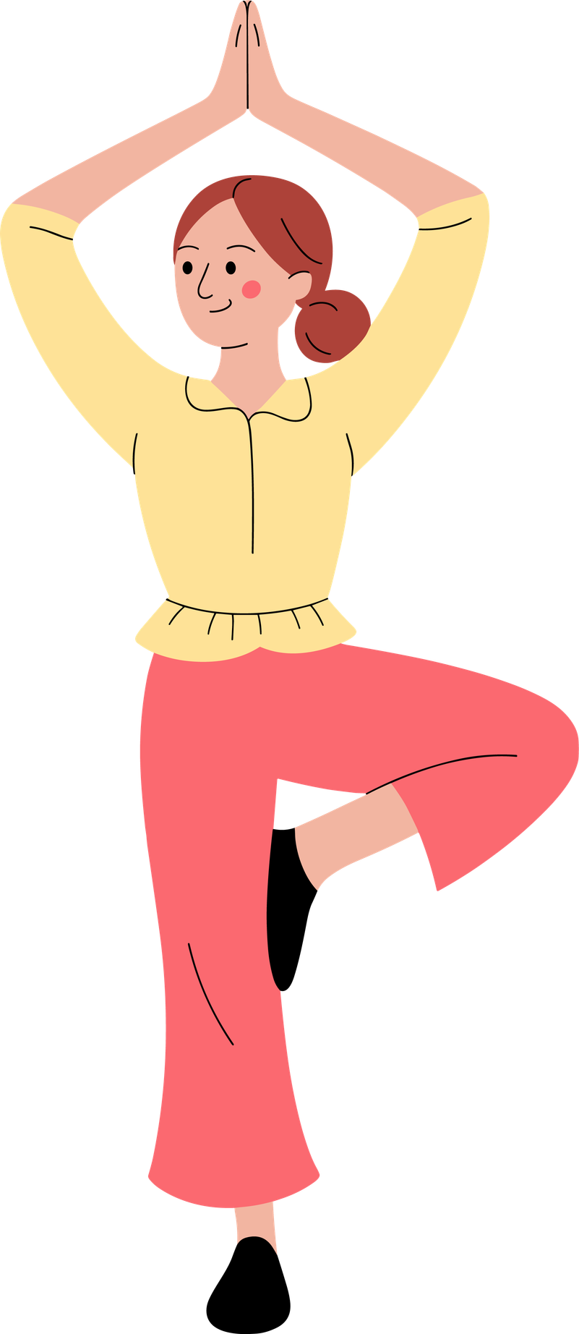
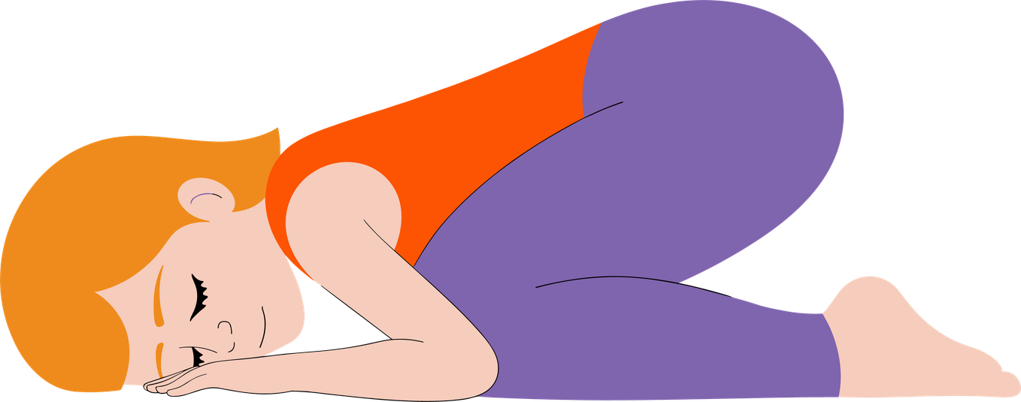
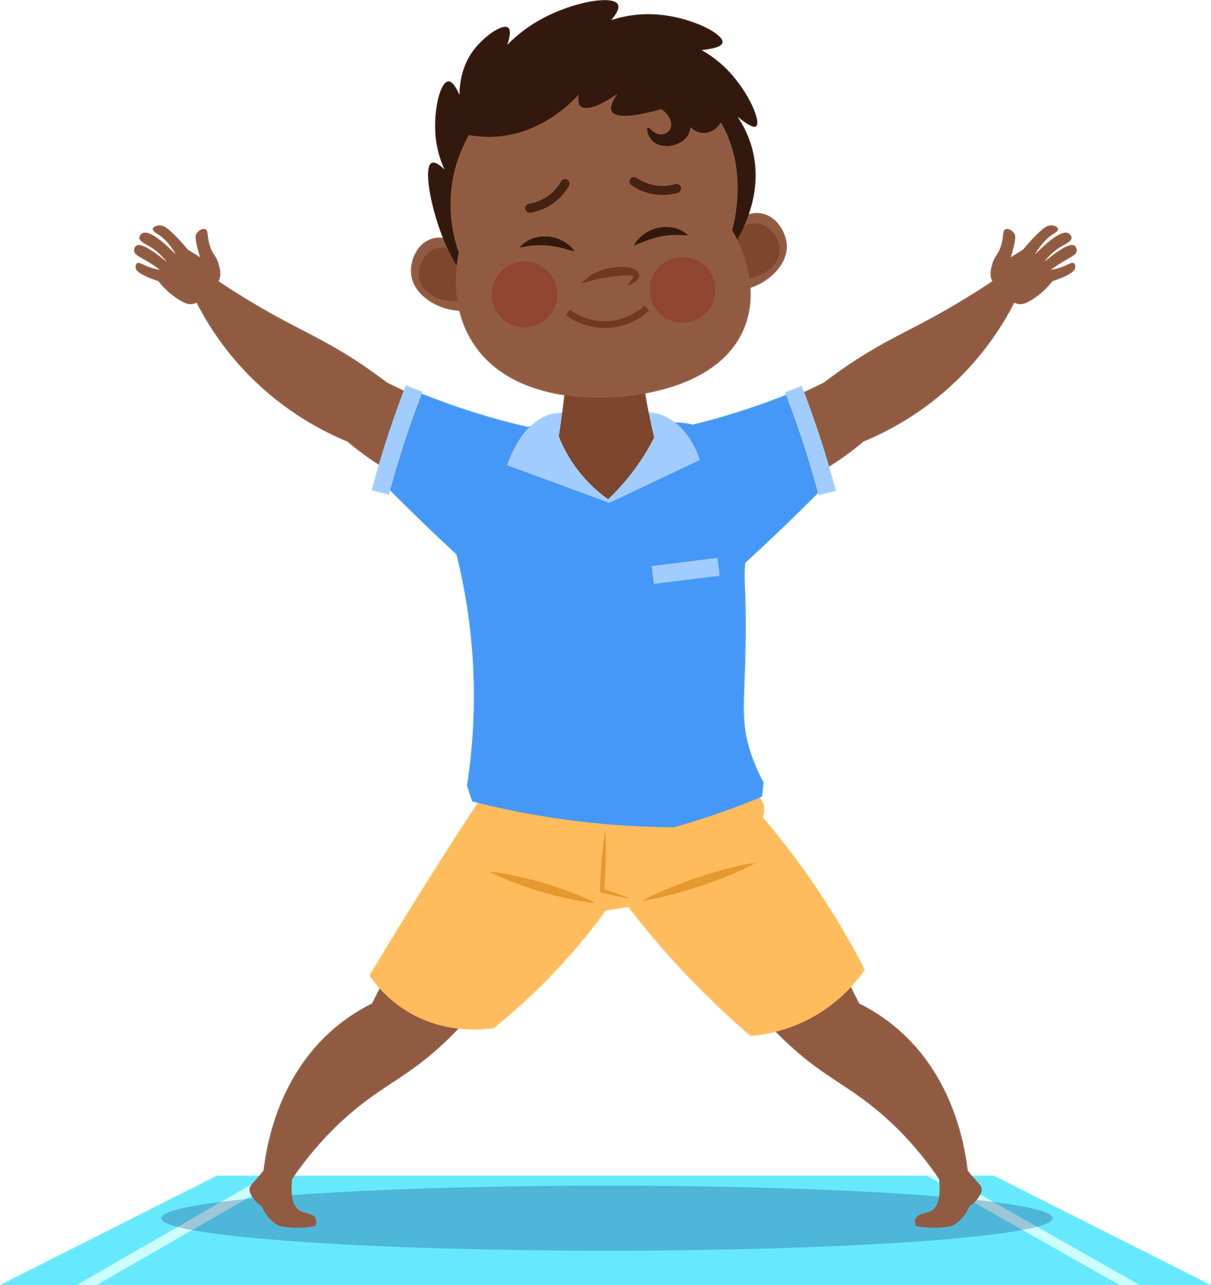
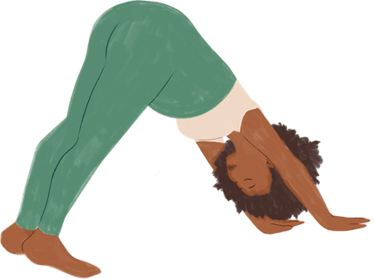
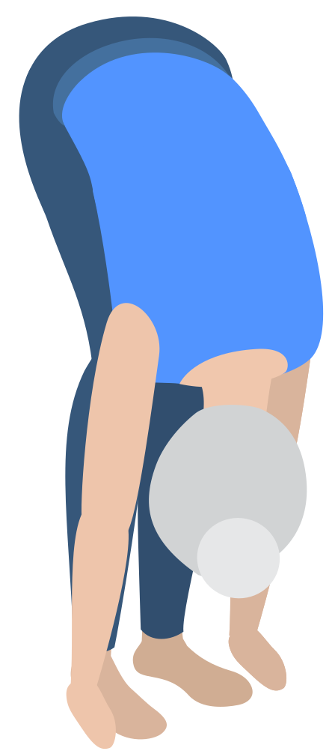
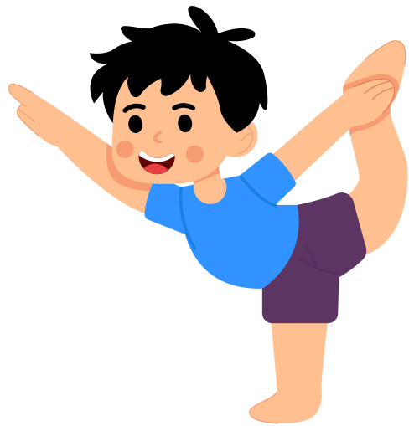
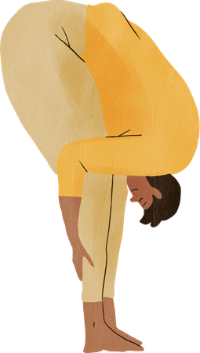
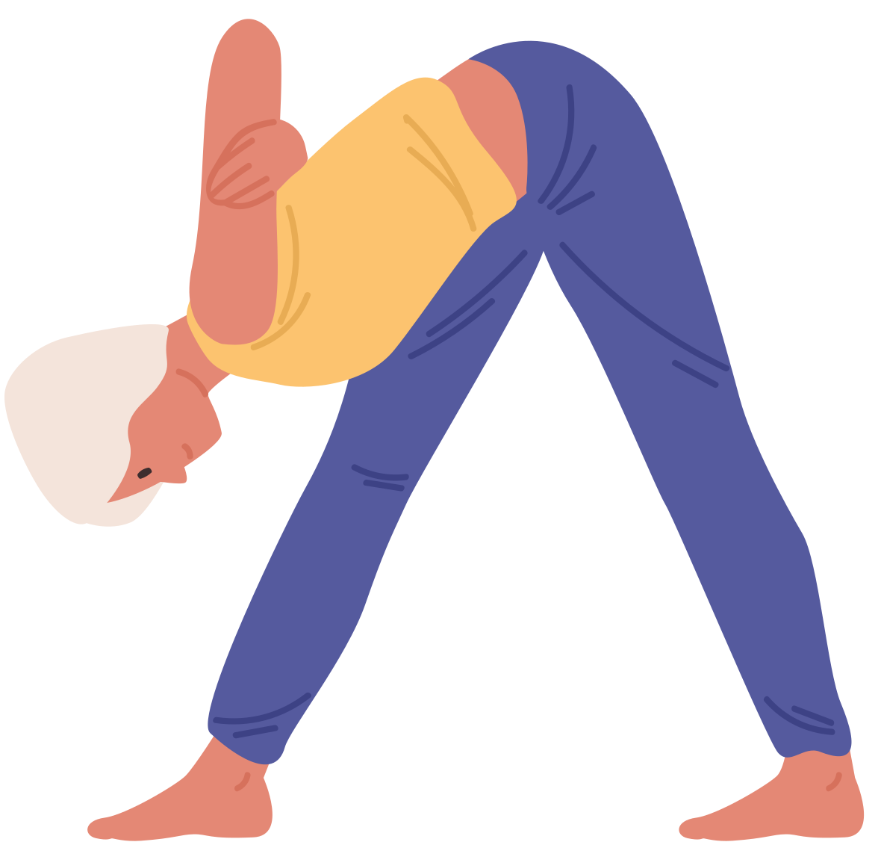
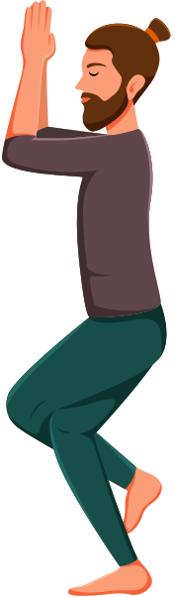

Try these movements for RESETS:
Angry
repeat on each side
Silly
repeat on each side
Overwhelmed
©2026 Pencil Box Solutions

Slide 25
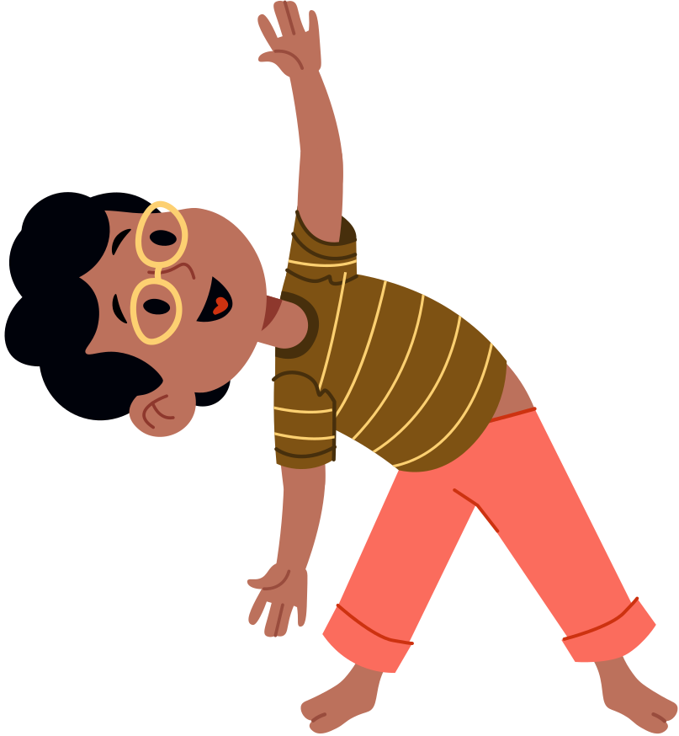
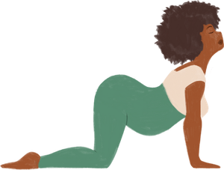
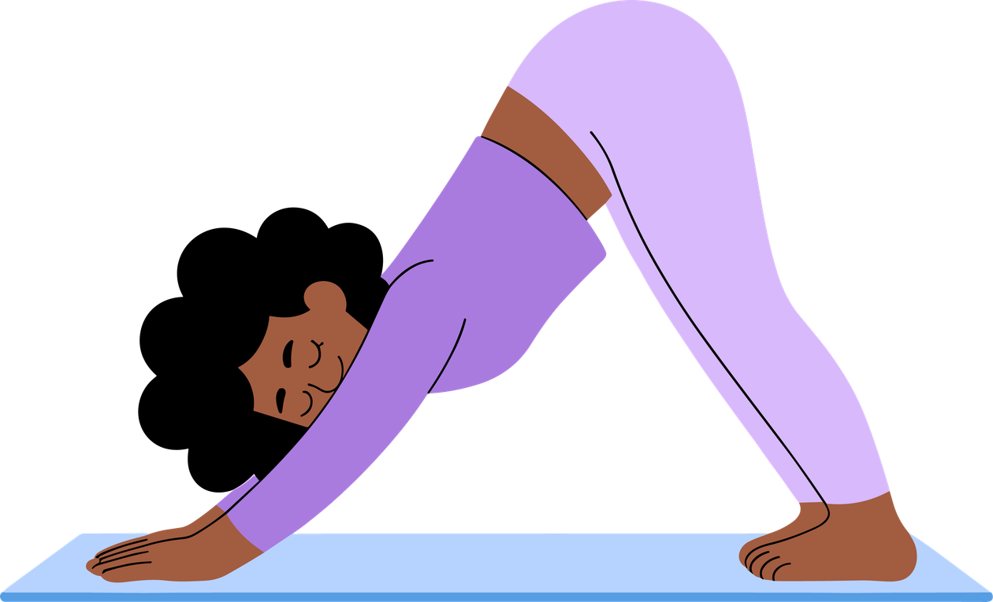
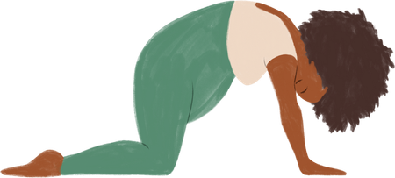
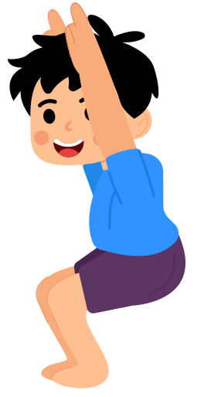
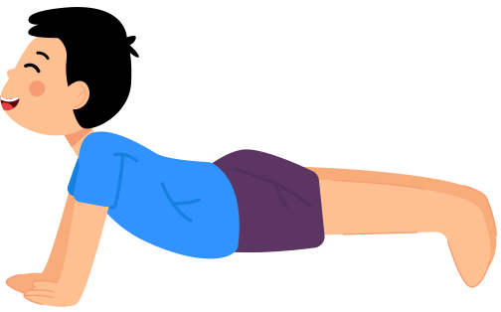
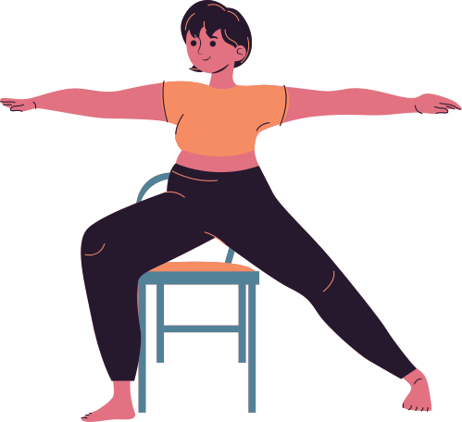
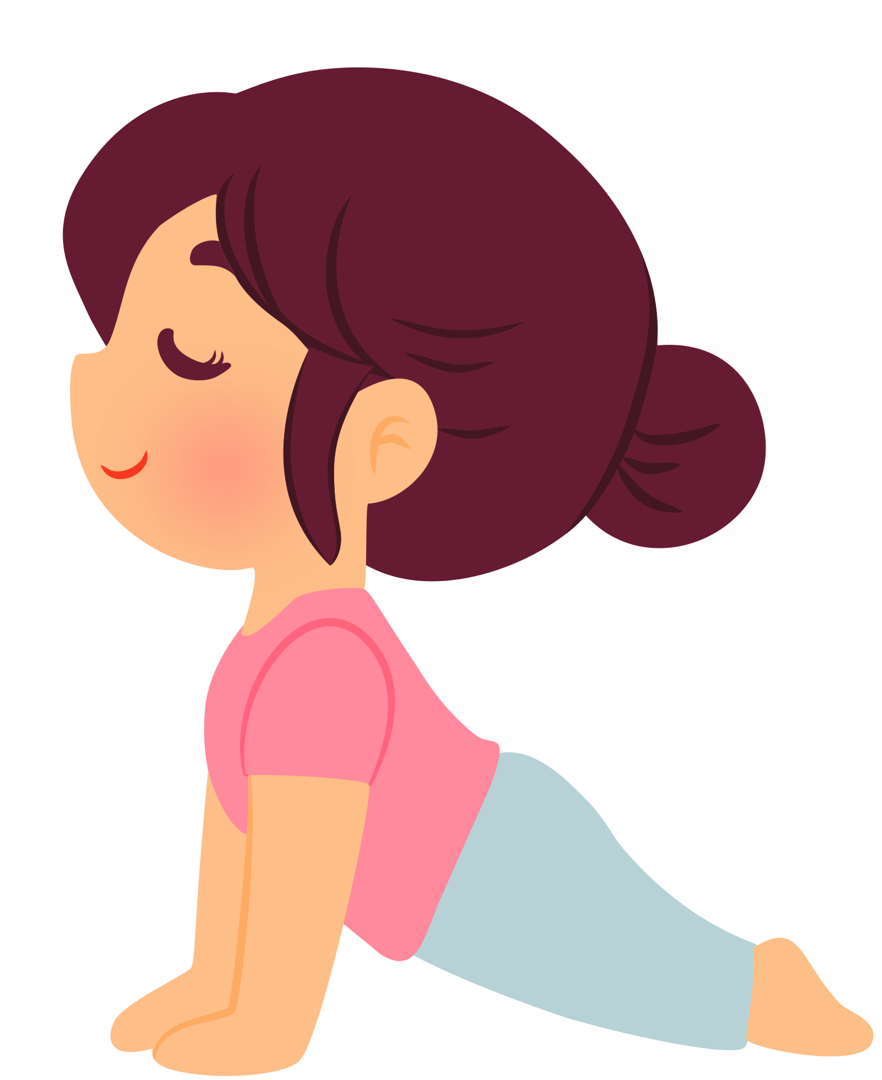
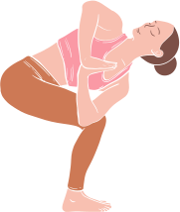
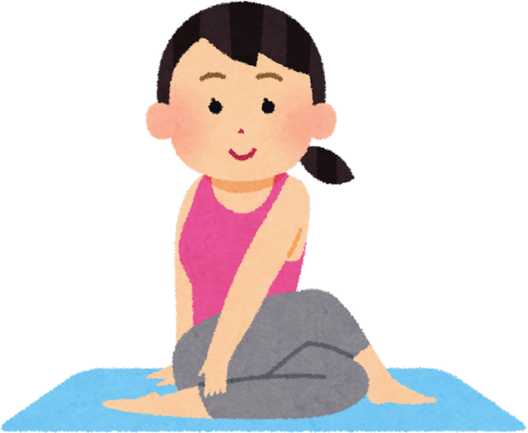
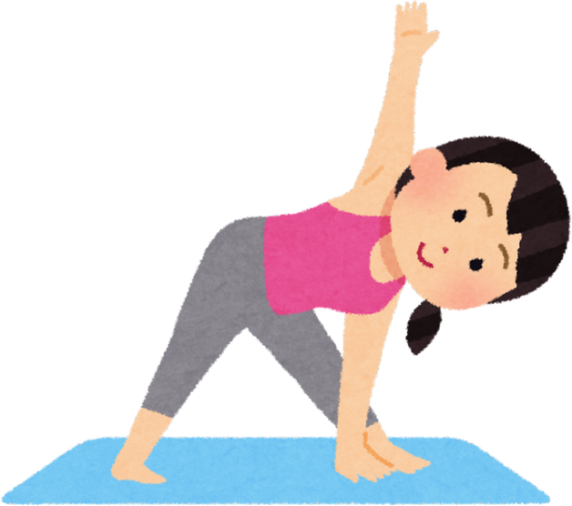
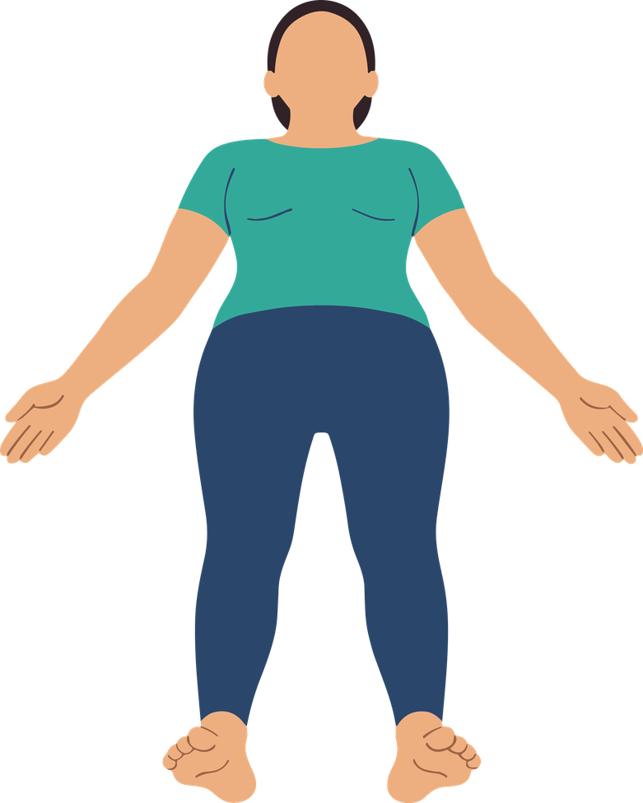
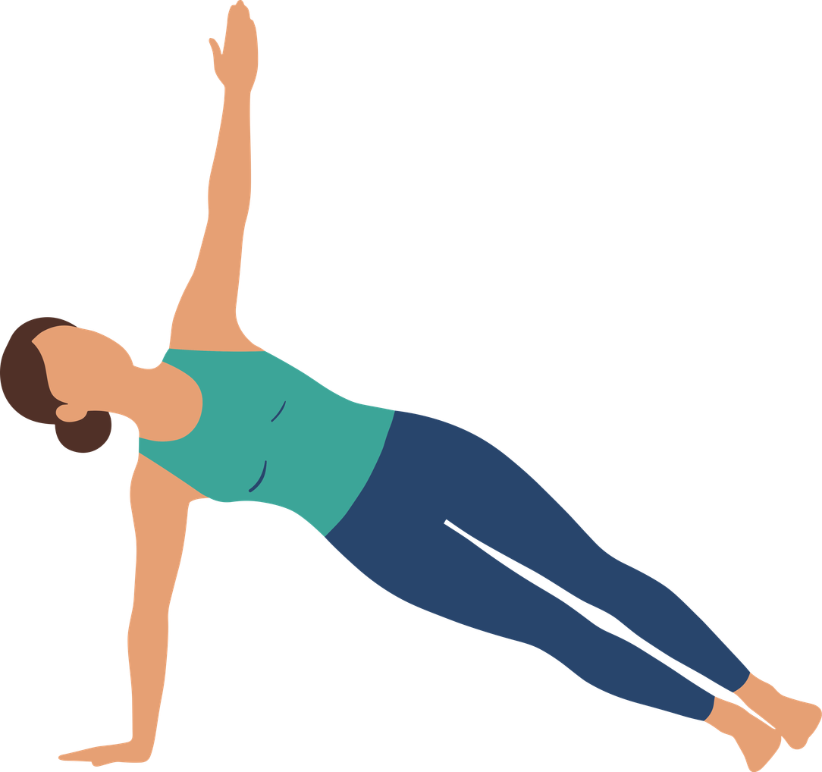
Try these movements for RESETS:
Frustrated
repeat on each side
Tired
repeat on each side
Restless
repeat on each side
©2026 Pencil Box Solutions

Slide 26
Week Three
Day Four
©2026 Pencil Box Solutions

Slide 27
Day Four
Today we’re going to talk about creating safe spaces for our brains and bodies. Sometimes, when our “downstairs brain” feels triggered or overwhelmed, big emotions show up and can feel hard to handle. A safe space gives us a place to pause, calm down, and remember that we are safe. When we choose a safe space, we’re not ignoring our feelings, we’re honoring them while helping ourselves feel steady again. Let’s explore together what kinds of safe spaces and tools we can use to help us when our emotions feel extra big.
©2026 Pencil Box Solutions

Slide 28
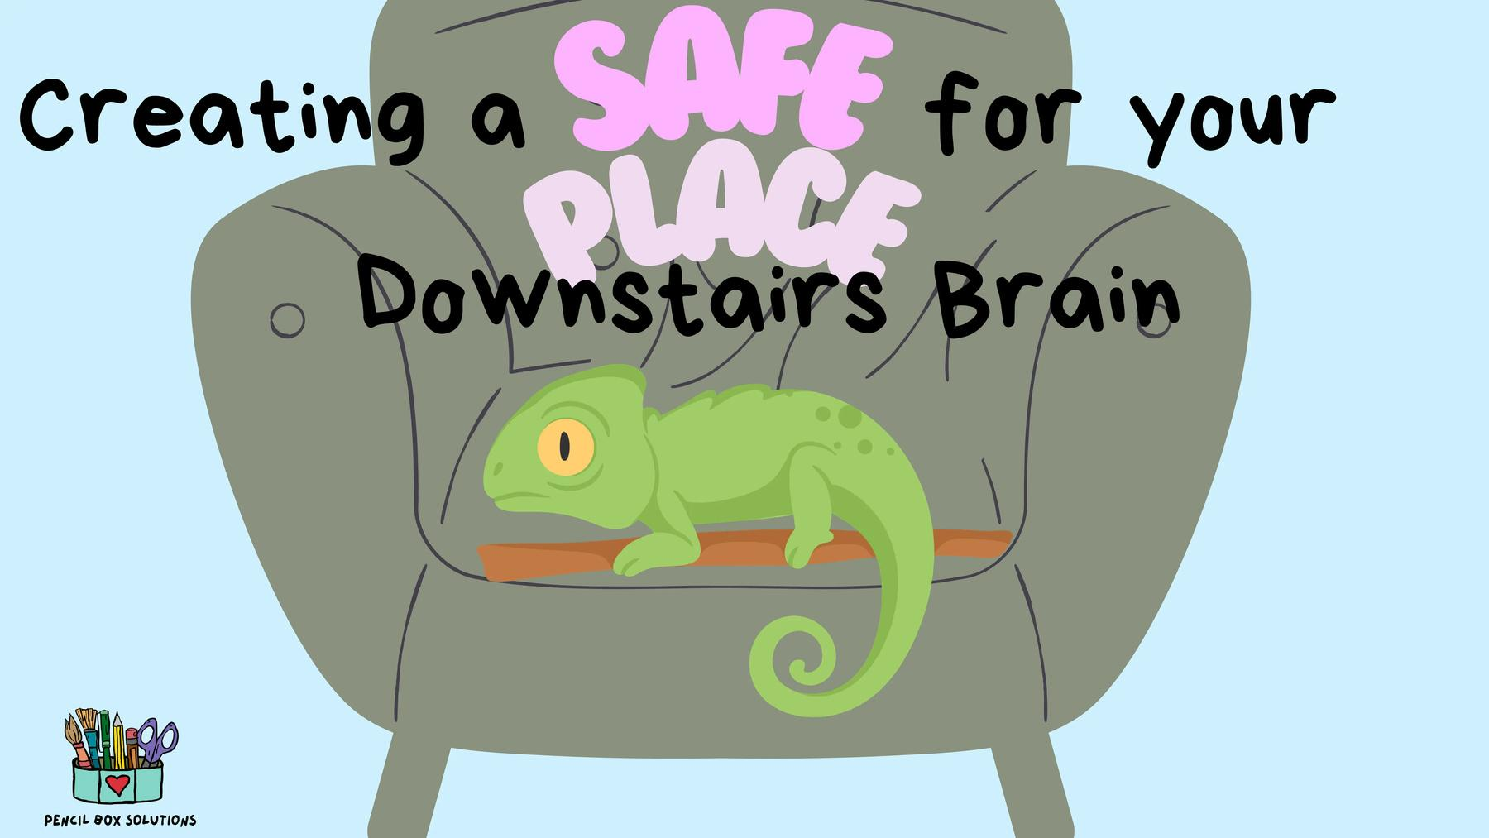
Making a Safe Place
For Our Downstairs Brain
©2026 Pencil Box Solutions

Slide 29



Recommended
Read Alouds
by Cori Doerrfeld
by Jaspreet Kaur
by Thich Nhat Hanh
©2026 Pencil Box Solutions

Slide 30
Activity:
What does your “safe space” look like?
Draw a picture of the people and the things you would bring with you into your “safe space”.
Compile all the pictures and put them in a binder for your calming corner.
©2026 Pencil Box Solutions

Slide 31

Week Three
Day Five
©2026 Pencil Box Solutions

Slide 32
Day Five
Today we are going to learn about a simple tool called P.B.S. It stands for Pause, Breathe, Smile.
Sometimes our thoughts and feelings can feel really busy or overwhelming, and this practice helps us slow down. When we pause, we give our brain a chance to rest. When we breathe, we bring calm and energy back into our body. And when we smile, we remind ourselves that we can choose peace and kindness and non-judgment in any moment.
©2026 Pencil Box Solutions

Slide 33

What does P.B.S. stand for?
Pause, Breathe, and Smile
of course
©2026 Pencil Box Solutions

Slide 34
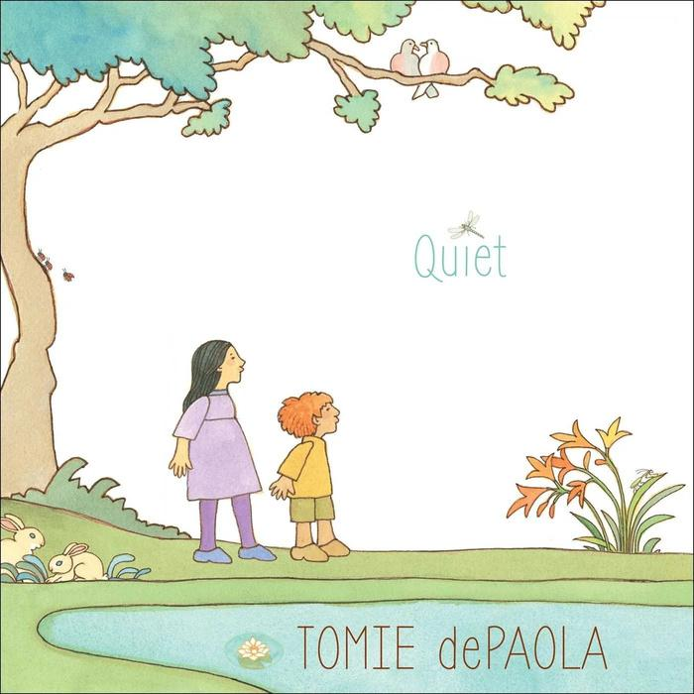


Recommended
Read Alouds
by Nick Ortner
by tomie dePaola
by Susan Verde & Peter H. Reynolds
©2026 Pencil Box Solutions

Slide 35
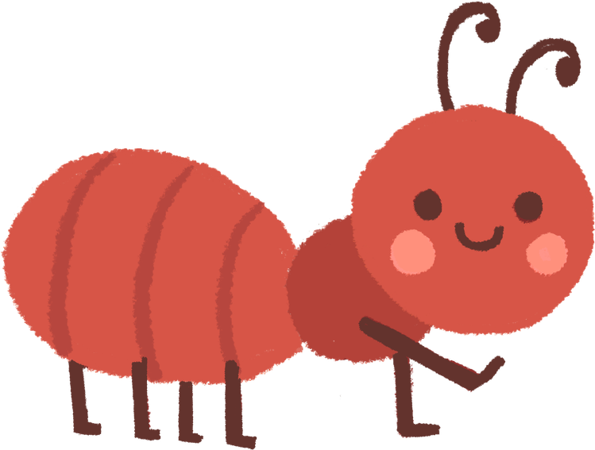


Today’s activity
Introduce several different types of BREATH exercises and let students explore which one they like best. (Download posters from the website.)
  Square Breathing
  Candle Breath/Windmill
  Belly Breathing
  Finger tracing
  What else do you know?
SYNTHESIS 1
Wow any audience with your Canva presentation. Design, plan and present all in one place.
SYNTHESIS 2
Wow any audience with your Canva presentation. Design, plan and present all in one place.
SYNTHESIS 3
Wow any audience with your Canva presentation. Design, plan and present all in one place.
©2026 Pencil Box Solutions

Slide 36

YOU DID IT!
WEEK THREE
©2026 Pencil Box Solutions

