Slide 1


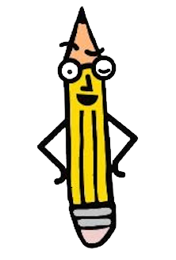
Morning Meeting Guide
Week Six

Slide 2



Morning Meetings
Dear Friend,
You are the greatest and most inspiring models your students will see this year at school. Every time you try something new, admit a mistake, or show courage in the face of challenge, you’re teaching them what real growth looks like. This week’s focus reminds us that learning is not about being perfect, it’s about being brave, open, and willing to grow. Your words and actions are shaping how your students see themselves, their abilities, and their futures. Thank you for modeling what it means to believe in progress, not perfection.
Greta and the Pencil Box Team

Slide 3


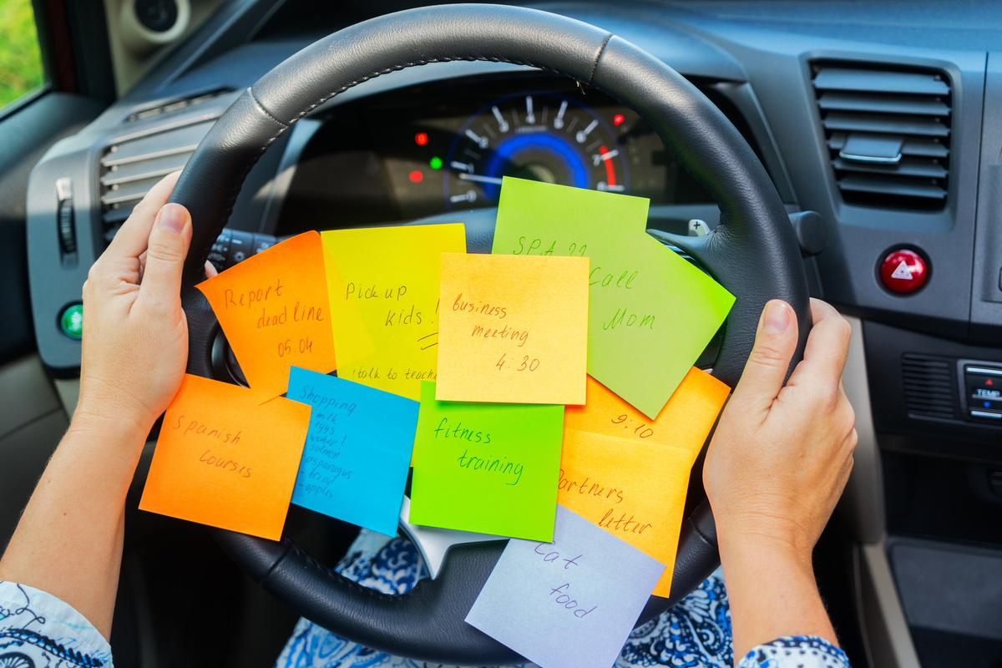
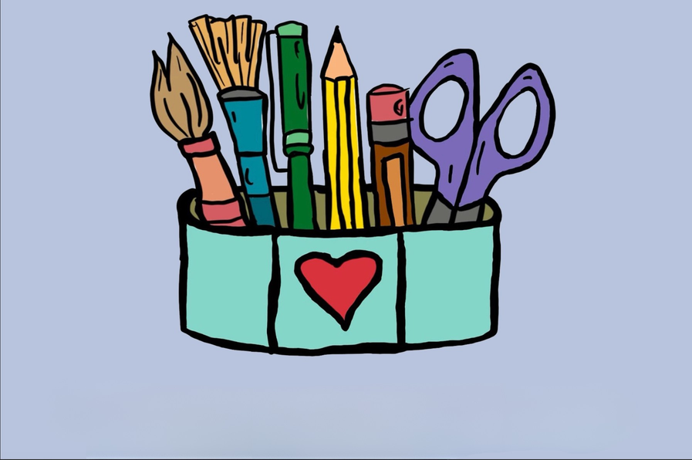

Week 6 Overview
Day 1
Day 2
Day 3
Day 5
Following
Directions
Be the Boss of Your Brain
Day 4
Oops, I’m Distracted Again
What is in Your Pencil Box?
Work Stamina Versus Work Avoidance

Slide 4

Week Six
Day One

Slide 5
Day One
Hey, team!
Concentration now in session! This week we are FOCUSING on FOCUS!
Sometimes it can feel like our brains have taken a little vacation and we have no idea what the teacher is talking about. And sometimes the vacation in our brain may seem more fun than what we are doing in class. BUT, the reality is that the work isn’t going away. It will still be there. Time to use our superpower called FOCUS. We will learn to notice our thoughts, bring our attention back to what we are supposed to be doing and then get our work done, so we can move on!

Slide 6
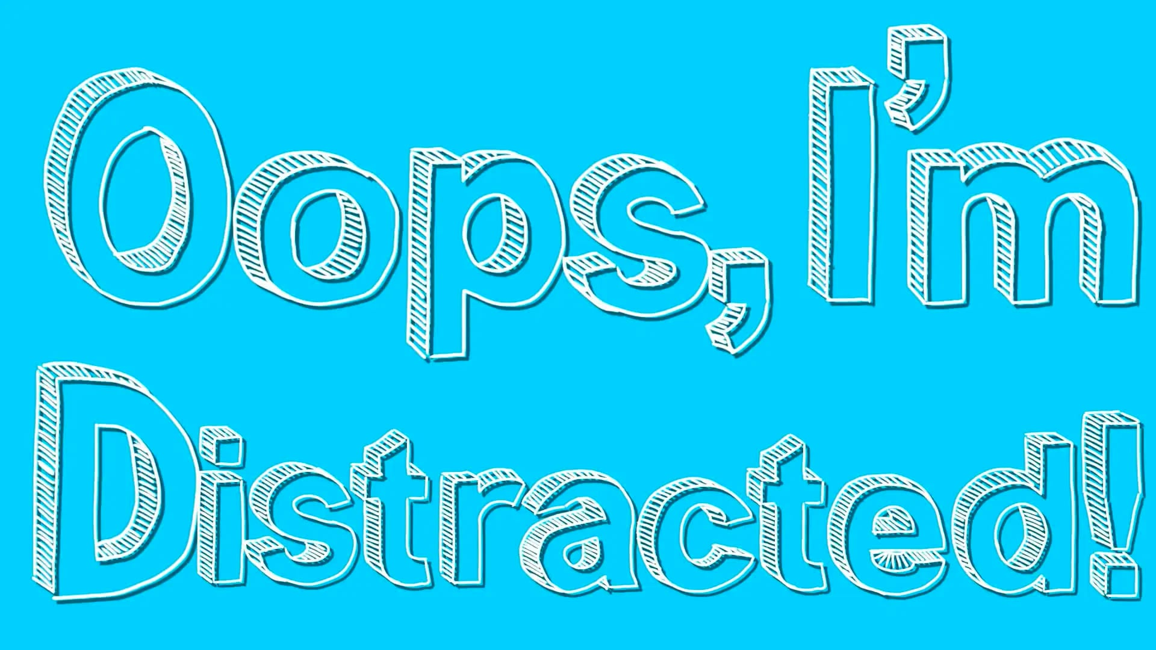
What Does It Mean to Focus?

Slide 7
Concentration 64
Setting Up the Rhythm
Sit in a circle or face a partner.
Start a steady beat: slap your legs, clap your hands, and snap your fingers (or tap alternating hands palm-up and palm-down with a partner).
Keep this exact beat going continuously throughout the game.
The Chant
While keeping the rhythm, all players chant together at the start:
Concentration, 64
No repeats or hesitation
I'll go first, you go second
The category is…

Slide 8
Concentration 64 continued
Playing the Game
The first player names an item that fits the category (for example, "dogs" if the category is animals) on the beat.
The next player names a different item in that same category on the next beat.
Play moves clockwise or back-and-forth.
Rules and Elimination
No repeats: You cannot say an item that was already named.
No hesitation: You must name an item immediately on your beat without pausing.
Out: If you repeat a word, hesitate, or miss the rhythm, you are out of the game.
The last person remaining wins, or you can restart with a new category.

Slide 9
Concentration 64 continued
Animals: Things with fur, ocean creatures, farm animals, insects/bugs, birds, zoo animals, reptiles, or animals that hibernate.
Nature & Weather: Types of trees, things you see in the sky, types of weather, flowers, things found in a park, or things that are green.
Pets: Popular dog breeds, names for a cat, things a pet needs, or pocket pets (like hamsters).
Animals: Things with fur, ocean creatures, farm animals, insects/bugs, birds, zoo animals, reptiles, or animals that hibernate.
Nature & Weather: Types of trees, things you see in the sky, types of weather, flowers, things found in a park, or things that are green.
Pets: Popular dog breeds, names for a cat, things a pet needs, or pocket pets (like hamsters).
Animals: Things with fur, ocean creatures, farm animals, insects/bugs, birds, zoo animals, reptiles, or animals that hibernate.
Nature & Weather: Types of trees, things you see in the sky, types of weather, flowers, things found in a park, or things that are green.
Pets: Popular dog breeds, names for a cat, things a pet needs, or pocket pets (like hamsters).
Movies & TV: Disney characters, superheroes, cartoon shows, animated villains, or movie snacks.
Books & Characters: Fairy tale characters, magical creatures, popular book series, or mythical animals like dragons and unicorns.
By Room: Things in the kitchen, items in a garage, things on a nightstand, bathroom items, or things in the backyard.
Daily Life: Items of clothing, shoes, things that plug into a wall, or things that keep you warm.
Descriptive: Things that are sticky, things that are loud, things that smell good (or bad!), things with wheels, things that have buttons, or things that spin.
Imaginative: Things you would pack for an alien planet, things a wizard uses, superpowers you wish you had, or things that are invisible.

Slide 10


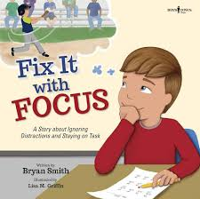

Recommended
Read Alouds
by Ryan K. Wooddall
by Alicia Ortega
by Bryan Smith

Slide 11
Week Six
Day Two

Slide 12
Day Two
Today we are going to jump back on the Brain Train again! When we get a little lost in our thoughts there are other tools we can use to figure out what we can do. And once you know the tips and tricks you will be able to turn your focus back into your super power!
There are clues that teachers leave for you all around the room. You will learn how to use your best detective skills to discover them!

Slide 13
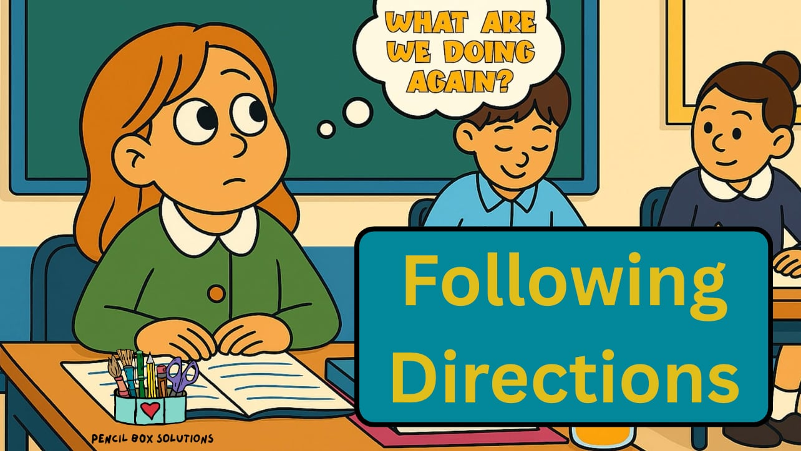
Following Directions

Slide 14
Following Directions Activity
Today will require a little preparation ahead of time. There will be two options. One for those who are readers (perhaps upper elementary) and another for those who are emergent readers (perhaps pre-k and primary).
Download and print one copy for each student linked here:
Emergent Readers (teacher reads aloud, students use pictures)
Primary Readers
Upper Elementary Readers

Slide 15

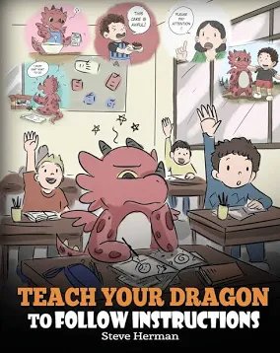

Recommended
Read Alouds
by Peggy Parrish
by Steve Herman
by David Shannon

Slide 16

Week Six
Day Three

Slide 17
Day Three
Good morning, Boss!
Hocus Pocus time to Focus. Today, we are leveling up our brains! Did you know your brain is the most powerful gaming console in the world?
Sometimes, when a task feels huge or difficult, our brain triggers an Overwhelm Alert. When that happens, you have the power to grab the controller and decide which part of your brain takes the lead:
The "Boss" Brain (Prefrontal Cortex): Your captain who plans, prioritizes, and makes smart choices.
The "Alarm" Brain (Amygdala): The quick reactor who gets worried, stressed, or distracted.

Slide 18
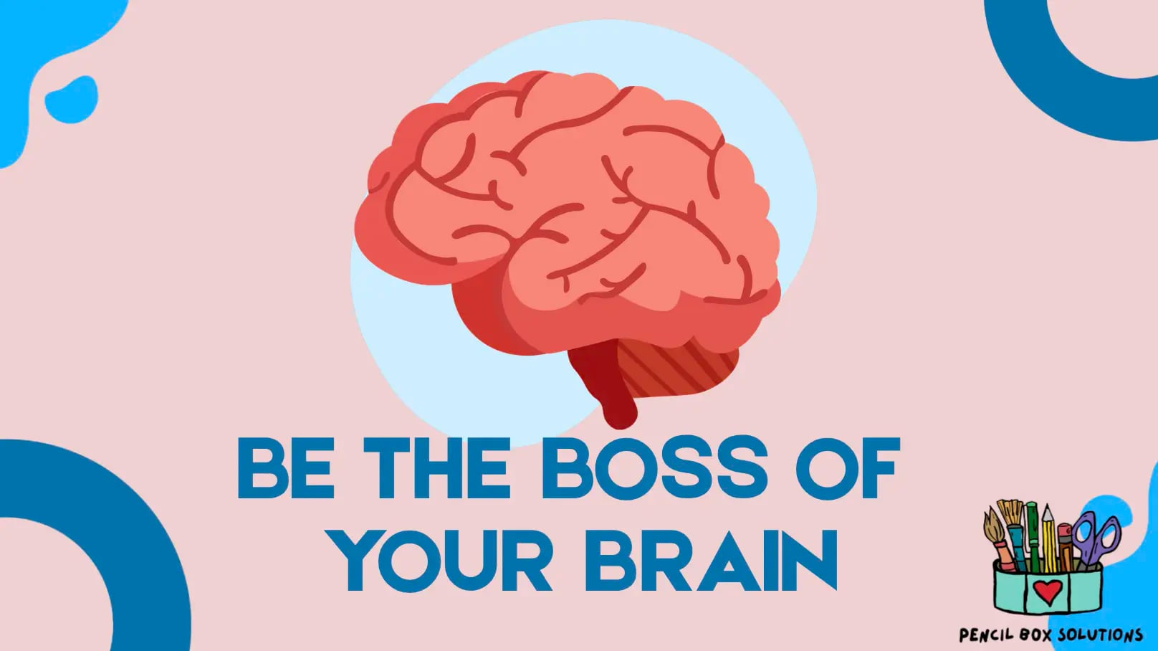
Be the Boss of
Your Own Brain

Slide 19
Stamina Activity 1
Materials Needed
A visible digital timer or stopwatch on the screen.
Scrap paper and pencil for each student (or whiteboards and dry-erase markers).
Stamina Tracker
How to Play (5 Minutes Total)
Minute 1: The Setup & "Dodge" Check
Announce the challenge:
"Today we’re fighting work avoidance. The trick to beating a hard task isn’t doing it all at once—it’s staying locked in for just one short focus burst without taking a fake break (no pencil sharpening, no sudden shoe-tying, suddenly needing a drink or bathroom break, or blowing your nose!)."

Slide 20
Activity
Minute 2: The Challenge Launch
Give them a fast, engaging micro-task that requires sustained attention.
  Option A (Creative): Draw as many distinct cartoon faces with different emotions as you can.
  Option B (Academic/Brain): Write down as many words starting with the letter S as you can think of.
  Option C (Math/Logic): Count backward from 100 by 3s on your board.
Minutes 3–4: The 60-Second Focus Burst
Hit Start on a 60-second countdown.
Rule: If their brain says "I want to give up" or "This is boring," they must use their self-talk power-up ("Just one more second!") and keep writing until the buzzer sounds.
The room must stay in absolute, laser-focused silence.

Slide 21



Recommended
Read Alouds
by Liz Haske
by Jolene Gutiérrez
by Bryan Smith

Slide 22
Activity
Minute 5: Dopamine Power-Up & Debrief
When the buzzer goes off, everyone stands up, drops their pencil, and shouts "LEVEL UP!" with two victory fist pumps.
Ask 2–3 quick hands: "Who felt like stopping around second 30?" and "How did you get past it?"
Wrap up with the takeaway: "That feeling you pushed through is work stamina. Today during independent work, when you feel stuck, just promise yourself one 60-second burst before asking for a break."

Slide 23
Week Six
Day Four

Slide 24
Day Four
Good morning, Team Stamina! Today we are practicing how to push through when work feels confusing or boring. We are going to be able to tell our friends what the word STAMINA means and begin to notice when we are AVOIDING our work. "Fake breaks are pretty common like sudden urges to sharpen your pencil or tie your shoes, or needing to get a drink or or go the bathroom, or even blowing your nose! You may think you are fooling a teacher, but we are able to see patterns of avoidance popping up. Noticing them, naming them, and making a different choice are all part of being the boss of your brain!

Slide 25
Stamina Activity 2
How to Play (5 Minutes Total)
Stamina Tracker
Minute 1: The Level-Up Briefing
"Yesterday, we crushed the 60-Second Boss Battle and proved our brains can stay locked-in. Today, we are leveling up our characters and doubling our stamina. We are moving from a 1-minute sprint to a 2-minute endurance quest. Your brain might try to trick you around the 1-minute mark and tell you to avoid the work. Your mission is to talk back to it and push through!"

Slide 26
Activity
How to Play (5 Minutes Total)
Minute 2: The Day 2 Challenge Launch
Give them a task that builds naturally on yesterday's categories, but allows for more sustained thought.
  If you did drawing yesterday: "The Mega-Doodle Quest." Draw one continuous scene (like an alien planet safari, or a crazy amusement park, an Ultimate Treehouse Fortress) without lifting your pencil from the paper or stopping for 2 full minutes.
More ideas continued on the next page

Slide 27
Activity
  If you did words yesterday: "The Chain-Word Quest." Write a chain of words where the last letter of one word becomes the first letter of the next (e.g., Cat \(\rightarrow \) Tiger \(\rightarrow \) Rabbit \(\rightarrow \) Train) for 2 full minutes.
  If you did the math challenge yesterday: "Skip Count starting with a Prime Number” and see as High as You Can Go! List of prime numbers. Choose one to start with and continue counting by that number. (2, 3, 5, 7, 11, 13, 17, 19, 23, 29)

Slide 28
Activity
How to Play (5 Minutes Total)
Minutes 3–4: The 2-Minute Focus Burst
  Set the visual timer for 2:00.
  Remind them: "No fake breaks. If you get stuck, don't stop writing—just look at what you already did and think of the next small piece."
  I will call out, "Stamina Check" at the 1-minute mark: "You are halfway there. Your brain might feel tired. But, power up your positive self-talk right now and keep your pencil moving!"

Slide 29
Activity
How to Play (5 Minutes Total)
Minute 5: The Dopamine Explosion & Debrief
When the buzzer sounds, have everyone stand up, jump up, and shout, "STAGE TWO CLEAR!"
Quick Reflective Share: "Put your hand on your head if your brain tried to quit around the middle of the timer. What secret power-up words did you tell yourself to make your hands keep working?"
The Takeaway: "Look at that! Your stamina just doubled in 24 hours. Keep that same 2-minute power ready for our math/reading/writing lessons later today."

Slide 30



Recommended
Read Alouds
by Andrea Beaty
by Gaia Cornwall
by Thompson and Qualls

Slide 31
Week Six
Day Five
©2025 Pencil Box Solutions

Slide 32
Day Five
Today we are going to look back at all the different skills we have learned about over the last several weeks.
We’ve worked hard and now we get to put into practice all that we’ve learned.
Will we mess up? You bet.
Will we get frustrated? For sure, from time to time.
Will we feel hopeful, overwhelmed, joyful, hurt, excited, sad, angry, jubilant, anxious or any of the many other feelings that we can have? YES! But we’ve learned that no emotion is good or bad. It is just a message to our brains.

Slide 33

What’s in YOUR Pencil Box?
Flower Box Breathing
Warm Up

Slide 34
What’s in your pencil box?
Let’s Review
Can you name the 3 Ns?
Can you list some of the “bad” emotions?
I can’t do it !
________
If we have hurt someone we need to
A , O , and M O
________
-___ - ___
______
____
What does P. B. S. stand for?

Slide 35
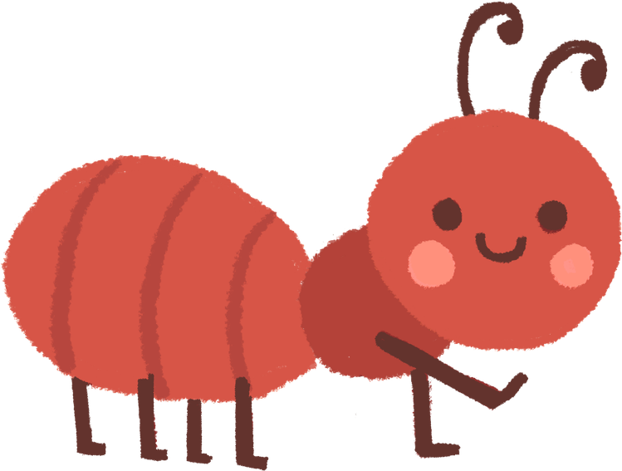


Today’s activity
Today we are going to look through our original class agreement from week one. We are going to revise it using some of the language we have learned over the last six weeks.
Do we want to add things to it?
Do we want to take things out?
When we finish we will all sign our new agreement.
SYNTHESIS 1
Wow any audience with your Canva presentation. Design, plan and present all in one place.
SYNTHESIS 2
Wow any audience with your Canva presentation. Design, plan and present all in one place.
SYNTHESIS 3
Wow any audience with your Canva presentation. Design, plan and present all in one place.

Slide 36
Optional Activity Stamina check 3
Day 3 Activity: The 3-Minute Combo Quest (5 Minutes Total)
Minute 1: The Level-Up Briefing
"Welcome to Day 3, Team Stamina! Look at our chart—we started at 1 minute, moved to 2 minutes, and today we are attempting a 3-Minute Combo Quest. Today’s secret to fighting overwhelm is pivoting. If you get stuck on one part of a task, don't stop or avoid the work. Just switch your strategy or move to a different section and keep your momentum going!"
Minute 2: The Day 3 Challenge Launch
Give them a task with built-in variety so they can practice pivoting when they run out of ideas.
  The Task: "The Category Combo." On your board, draw three columns: Animals, Foods, and Games. For 3 full minutes, you must list as many items as possible. If your brain freezes in the Animal column, pivot to Foods or Games immediately. Keep the pencil moving!

Slide 37
Optional Activity Stamina check 3
Minutes 3–5: The 3-Minute Endurance Sprint
Set the visual timer for 3:00.
Mid-Way Coach Call (1:30): "You are at the halfway mark! If you feel stuck, pivot to a new column! Don't let your brain take a fake break!"
The Final Push (2:30): "Last 30 seconds! This is where real stamina is built. Push through!"
After the Buzzer: The Dopamine Explosion!
Everyone stands, strikes a superhero pose, and shouts, "COMBO UNLOCKED!"
Update the tracking chart together to celebrate the win!

Slide 38

YOU DID IT!
WEEK SIX

